Slide 1
Deep Learning for Information Processing & Artificial Intelligence New-Generation Models & Methodology for Advancing AI & SIP
Li Deng
Microsoft Research, Redmond, USA
Tianjin University, July 2-5, 2013
(including joint work with colleagues at MSR, U of Toronto, etc.)

Slide 2
- Survey of audience background (>500 registrants: too many to accommodate all) - Teaching material PART I: Basics of Deep Learning PART II: Modern (as of ICASSP, May 2013 & ICML, June, 2013)
DAY one: July 2, 2013

Slide 3
Teaching Material
Plus:
Coursera video/slides of Geoff Hinton: Neural Nets for Machine Learning 2012 (w. his kind permission)
Coursera video/slides of Computational Neuroscience, 2013 (w. Prof. Rajesh Rao’s kind permission)
Slides of Yann LeCun, Geoff Hinton, Vincent Vanhouke, etc. (w. authors’ kind permission)
Slide presentations in various tutorials, keynotes, lectures, and conference presentations by me, some jointly w. my MSR colleagues (D. Yu, etc.)
Optional for speech: my other books

Slide 5

Li Deng and Doug O'Shaughnessy,
SPEECH PROCESSING --- A Dynamic and Optimization-Oriented Approach,
Marcel Dekker Inc., June 2003 (626 pages).
TABLE OF CONTENTS
PART I: Analytical Background and Techniques
Chapter 1: Discrete-Time Signals, Systems, and Transforms
Chapter 2: Analysis of Discrete-Time Speech Signals
Chapter 3: Probability and Random Processes
Chapter 4: Linear Model and Dynamic System Model
Chapter 5: Optimization Methods and Estimation Theory
Chapter 6: Statistical Pattern Recognition
PART II: Fundamentals of Speech Science
Chapter 7: Phonetic Process
Chapter 8: Phonological Process
PART III: Computational Phonology and Phonetics
Chapter 9: Computational Phonology
Chapter 10: Computational Models for Speech Production
Chapter 11: Computational Models for Auditory Speech Processing
PART IV: Speech Technology in Selected Areas
Chapter 12: Speech Recognition
Chapter 13: Speech Enhancement
Chapter 14: Speech Synthesis

Slide 6
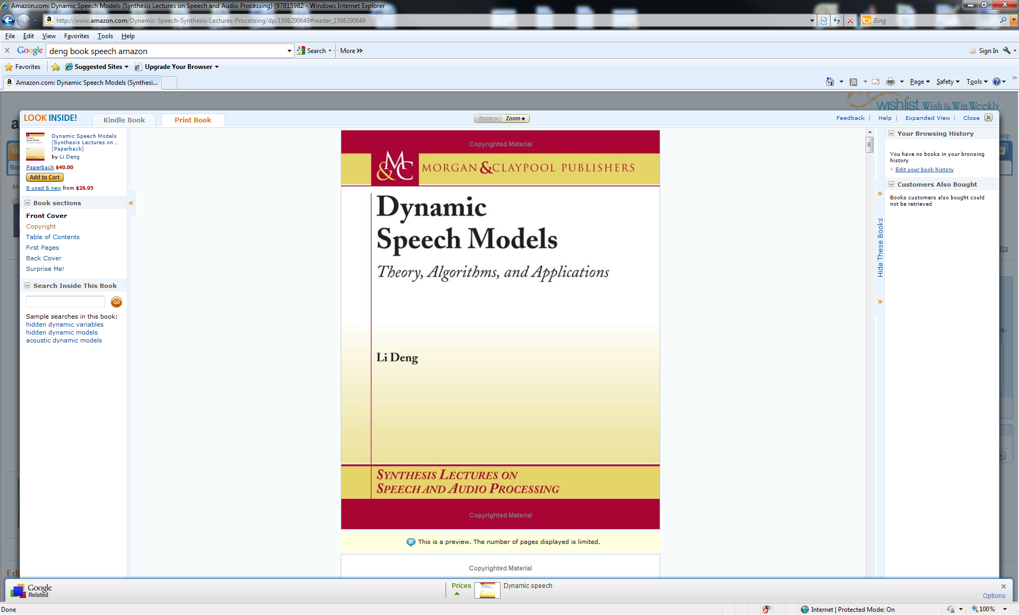
Li Deng, DYNAMIC SPEECH MODELS --- Theory, Algorithm, and Application; (book review in IEEE Trans. Neural Networks, Vol. March 2009), Morgan & Claypool, December 2006.
TABLE OF CONTENTS
Chapter 1: Introduction
1.1 What Are Speech Dynamics?
1.2 What Are Dynamic Speech Models?
1.3 Why Modeling Speech Dynamics?
1.4 Outline of the Book
Chapter 2: A General Modeling And Computational Framework
2.1 Background and Literature Review
2.2 Model Design Philosophy and Overview
2.3 Model Components and the Computational Framework
2.4 Summary
Chapter 3: Modeling: From Acoustic Dynamics To Hidden Dynamics
3.1 Background and Introduction
3.2 Statistical Models for Acoustic Speech Dynamics
3.3 Statistical Models for Hidden Speech Dynamics
3.4 Summary
Chapter 4: Models With Discrete Valued Hidden Speech Dynamics
4.1 Basic Model with Discretized Hidden Dynamics
4.2 Extension of the Basic Model
4.3 Application to Automatic Tracking of Hidden Dynamics
Chapter 5: Models With Continuous Valued Hidden Speech Trajectories
5.1 Overview of the Hidden Trajectory Model
5.2 Understanding Model Behavior by Computer Simulation
5.3 Parameter Estimation
5.4 Application to Phonetic Recognition
5.5 Summary
References

Slide 7


Slide 8




Plenary Keynote (9:50-10:40am, May 28)
Recent Developments in
Deep Neural Networks
Geoffrey E. Hinton
Host: Li Deng

Slide 9
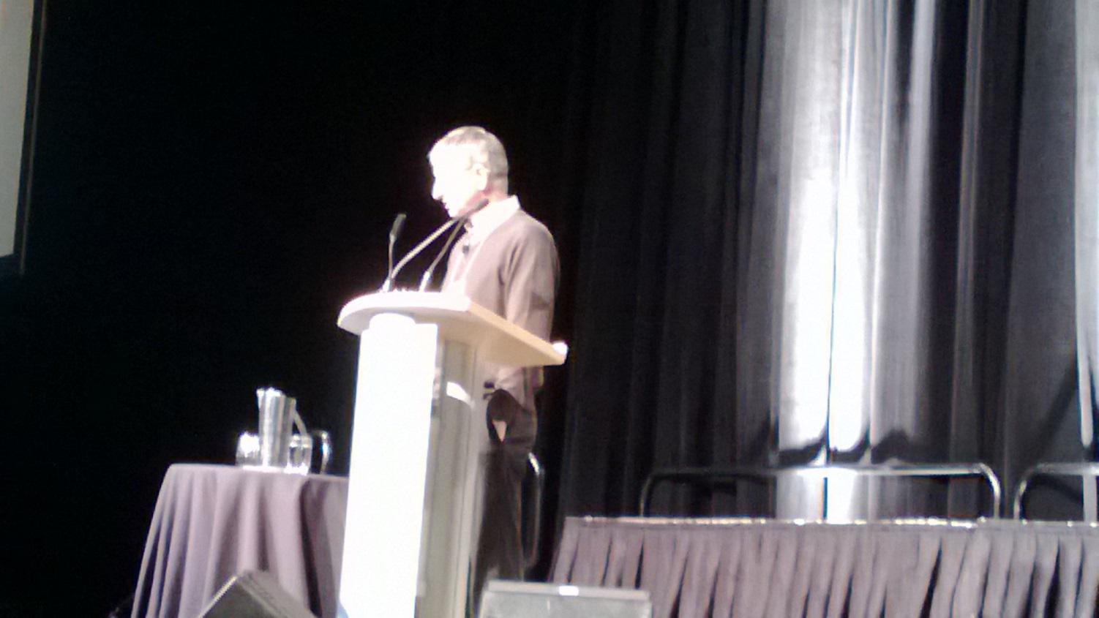
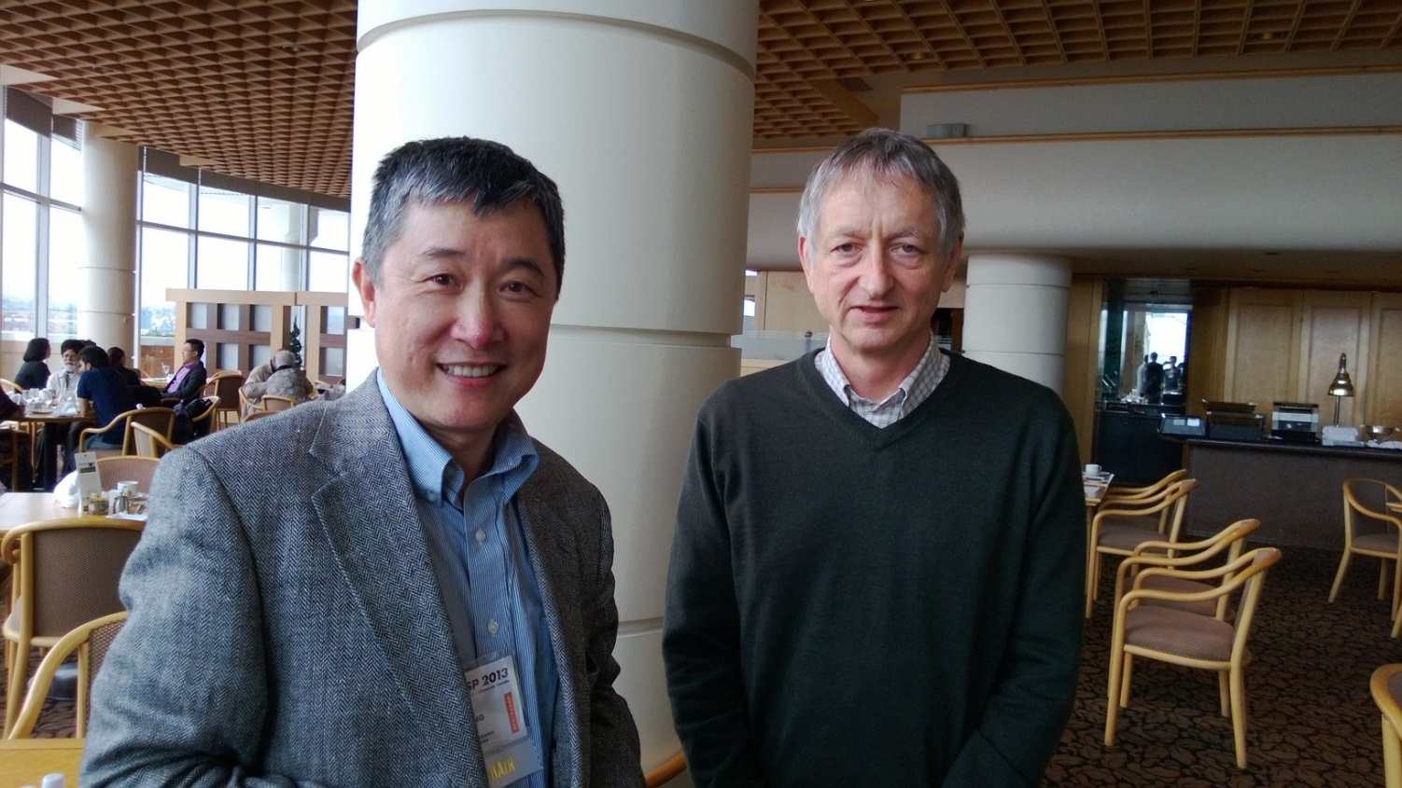

Slide 10
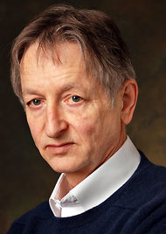

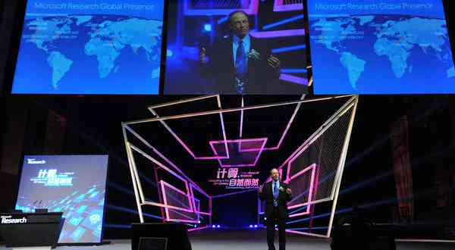
Scientists See Promise in Deep-Learning Programs
John Markoff
November 23, 2012
Rich Rashid in Tianjin, October, 2012
Geoff Hinton
Notes:
I am going to make my introduction short to our keynote speaker today, Prof. Geoff Hinton.
Skipping his life-long remarkable achievements, I just want to say that Geoff designs machine learning algorithms
and has been extremely active and playing the pioneering and leadership roles in research of the topic area in this keynote
--- deep learning, which he established in 2006 as briefly described in this recent NYT article in case you have read it.
The NYT reporter John Markoff interviewed Geoff and me, among others, last fall,
and wrote Geoff’s recent research achievements very concisely,
which you will hear firsthand from him today, plus more recent advances since the article was written.
As a personal note, in Decembers of 2009 and 2010 when NNs were still “in the cold winter”,
my company and I were very fortunate to be able to attract Geoff to come to MSR (working side-by-side in my office),
and we started industry-scale speech applications.
I learned tremendously from him during those “cold winters” in Seattle.
Now, as witnessed by the very large number of DNN papers in our ICASSP,
Geoff has brought the “spring” season of NN to the world again (last time in 1986), this time with a “deep” flavor and with truly useful applications.
You will heard all this from his keynote talk now.
So here we have, Prof. Geoff Hinton.
====================
You may have heard of this real-time speech-to-speech translation demo that was presented in Beijing by Rick Rashid. This demo is only possible because of some remarkable advances in speech processing: we’ve tried it over the previous two years, and it didn’t work.

Slide 11
Useful Sites on Deep Learning
http://deeplearning.net/reading-list/ (Bengio’s group)
http://deeplearning.net/deep-learning-research-groups-and-labs/
http://ufldl.stanford.edu/wiki/index.php/UFLDL_Recommended_Readings
http://www.cs.toronto.edu/~hinton/
http://deeplearning.net/tutorial/
http://ufldl.stanford.edu/wiki/index.php/UFLDL_Tutorial (Andrew Ng’s group)
Google+ Deep Learning community
Notes:
Contextual dynamics; massive parameters vs parsimonious params; constraints in RNN.

Slide 12
http://deeplearning.net/deep-learning-research-groups-and-labs/
Deep Learning Research Groups
Some labs and research groups that are actively working on deep learning:
University of Toronto - Machine Learning Group (Geoff Hinton, Rich Zemel, Ruslan Salakhutdinov, Brendan Frey, Radford Neal)
Université de Montréal - Lisa Lab (Yoshua Bengio, Pascal Vincent, Aaron Courville, Roland Memisevic)
New York University – Yann Lecun‘s and Rob Fergus‘ group
Stanford University – Andrew Ng‘s group
UBC – Nando de Freitas‘s group
Google Research – Jeff Dean, Samy Bengio, Jason Weston, Marc’Aurelio Ranzato, Dumitru Erhan, Quoc Le et al
Microsoft Research – Li Deng et al
SUPSI – IDSIA (Schmidhuber’s group)
UC Berkeley – Bruno Olshausen‘s group
University of Washington – Pedro Domingos‘ group
IDIAP Research Institute - Ronan Collobert‘s group
University of California Merced – Miguel A. Carreira-Perpinan‘s group
University of Helsinki - Aapo Hyvärinen‘s Neuroinformatics group
Université de Sherbrooke – Hugo Larochelle‘s group
University of Guelph – Graham Taylor‘s group
University of Michigan – Honglak Lee‘s group
Technical University of Berlin – Klaus-Robert Muller‘s group
Baidu – Kai Yu‘s group
Aalto University – Juha Karhunen‘s group
U. Amsterdam – Max Welling‘s group
U. California Irvine – Pierre Baldi‘s group
Ghent University – Benjamin Shrauwen‘s group
University of Tennessee – Itamar Arel‘s group
IBM Research – Brian Kingsbury et al
University of Bonn – Sven Behnke’s group
Gatsby Unit @ University College London – Maneesh Sahani, Yee-Whye Teh, Peter Dayan
Last modified on April 10, 2013, at 1:27 pm by Caglar Gulcehre

Slide 13
Outline
Part I. A: Deep Learning
A quick Tutorial (RBM, DBN, DNN-HMM, DCN/DSN)
A brief history on how speech industry started exploring deep learning with success stories (replacing GMM so far)
Current success on speech recognition
Part I. B: Dynamic Models and Learning
DBN*, HDM, HTM, segment models, etc.
A longer, separate history and a critical review
Part I. C: Connecting the Dots
Linguistic hierarchy in dynamic human speech
Exploiting hierarchical dynamics in deep learning framework
Notes:
Contextual dynamics; massive parameters vs parsimonious params; constraints in RNN.

Slide 14
Outline
Deep Learning
A Tutorial (RBM, DBN, DNN-HMM, DCN)
A brief history on how speech industry started exploring deep learning with success stories (replacing GMM so far)
Current success on speech recognition
Dynamic Models and Learning
DBN*, HDM, HTM, segment models, etc.
A longer history and a critical review
Connecting the Dots
Linguistic hierarchy in dynamic human speech
Exploiting hierarchical dynamics in deep learning framework
Notes:
Contextual dynamics; massive parameters vs parsimonious params; constraints in RNN.

Slide 15
Review of Deep Learning Basics
Deep Learning (aka Deep Structured Learning, Hierarchical Learning): a class of machine learning techniques, where many layers of information processing stages in hierarchical architectures are exploited for unsupervised feature learning and for pattern analysis/classification.
Deep belief nets (DBN): probabilistic generative models composed of multiple layers of stochastic, hidden variables. The top two layers have undirected, symmetric connections between them. The lower layers receive top-down, directed connections from the layer above. (key: stacked RBMs; Hinton: Science, 2006)
Boltzmann machine (BM): a network of symmetrically connected, neuron-like units that make stochastic decisions about whether to be on or off.
Restricted Boltzmann machine (RBM): a special BM consisting of a layer of visible units and a layer of hidden units with no visible-visible or hidden-hidden connections. (Key: contrastive divergence learning)
Deep neural nets (DNN, or “DBN” before Nov 2012): multilayer perceptrons with many hidden layers, whose weights are often initialized (pre-trained) using stacked RBMs or DBN (DBN-DNN) or discriminative pre-training.
Deep auto-encoder: a DNN whose output is the data input itself, often pre-trained with DBN (Deng/Hinton, interspeech 2010; Hinton, Science 2006)
Distributed representation: a representation of the observed data in such a way that they are modeled as being generated by the interactions of many hidden factors. A particular factor learned from configurations of other factors can often generalize well. Distributed representations form the basis of deep learning.

Slide 16
More on “Deep Learning”
Definition 1: A class of machine learning techniques that exploit many layers of non-linear information processing for supervised or unsupervised feature extraction and transformation, and for pattern analysis and classification.
Definition 2: “A sub-field within machine learning that is based on algorithms for learning multiple levels of representation in order to model complex relationships among data. Higher-level features and concepts are thus defined in terms of lower-level ones, and such a hierarchy of features is called a deep architecture. Most of these models are based on unsupervised learning of representations.” (Wikipedia on “Deep Learning” around March 2012.)
Definition 3: “A sub-field of machine learning that is based on learning several levels of representations, corresponding to a hierarchy of features or factors or concepts, where higher-level concepts are defined from lower-level ones, and the same lower-level concepts can help to define many higher-level concepts. Deep learning is part of a broader family of machine learning methods based on learning representations. An observation (e.g., an image) can be represented in many ways (e.g., a vector of pixels), but some representations make it easier to learn tasks of interest (e.g., is this the image of a human face?) from examples, and research in this area attempts to define what makes better representations and how to learn them.” see Wikipedia on “Deep Learning” as of this writing in February 2013; see http://en.wikipedia.org/wiki/Deep_learning.
Definition 4: “Deep Learning is a new area of Machine Learning research, which has been introduced with the objective of moving Machine Learning closer to one of its original goals: Artificial Intelligence. Deep Learning is about learning multiple levels of representation and abstraction that help to make sense of data such as images, sound, and text.” See https://github.com/lisa-lab/DeepLearningTutorials

Slide 17
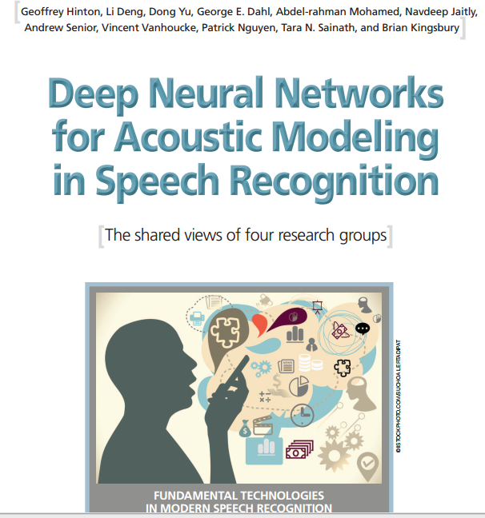

Slide 18
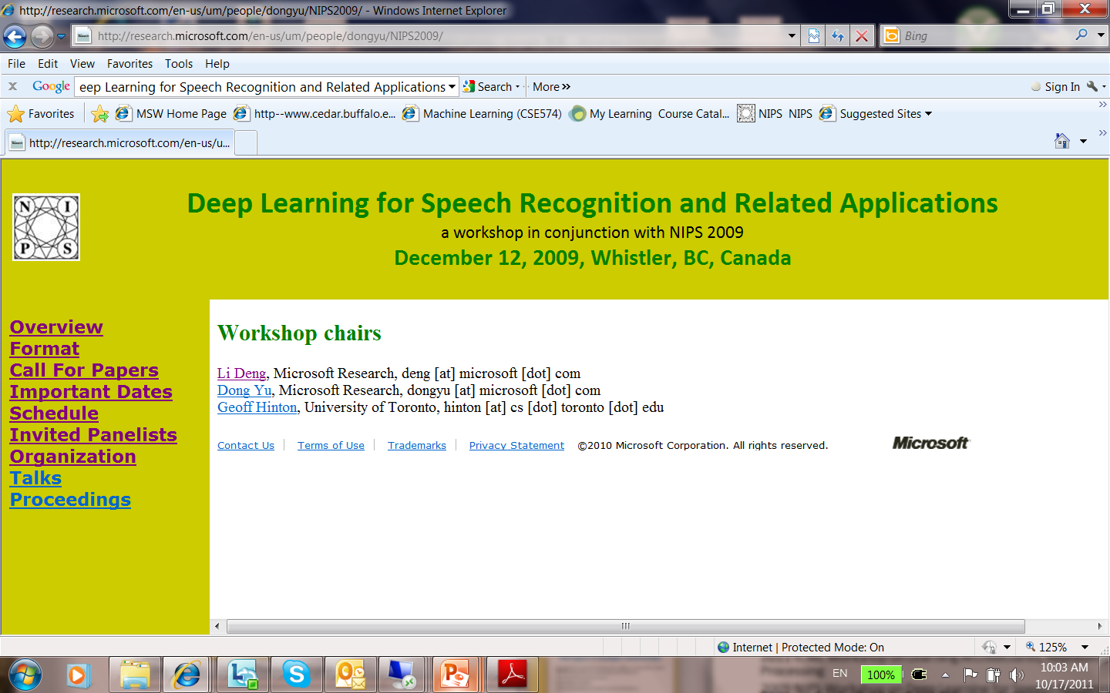
2011 ICML Workshop on Learning Architectures, Representations, and Optimization for Speech and Visual Information Processing
2009 NIPS Workshop on Deep Learning for Speech Recognition and Related Applications,
2009 ICML Workshop on Learning Feature Hierarchies
2008 NIPS Deep Learning Workshop
2009 NIPS Workshop on Deep Learning for Speech Recognition and Related Applications,
→2012: special issue on Deep Learning for Speech and Language Processing in IEEE Transactions on Audio, Speech, and Language Processing (Jan. 2012; intro in my EiC inaugural editorial)
2012: Joint special issue on “learning deep architectures” in IEEE Signal Processing Magazine (SPM) & IEEE Trans. Pattern Analysis and Machine Intelligence (PAMI) (under planning)
DARPA deep learning program, since 2009
Hot key words of “deep network” in 2011 Learning Workshop (Fort Lauderdale), NIPS 2010, ICASSP 2011 Trend Session (Speech/Language Proc.)
Tutorial on deep learning at ICASSP-2012, just accepted … …
First time deep learning shows promise in speech
recognition! And activities grew rapidly since then…

Slide 19
Deep Learning for Speech Recognition and Related Applications
Anecdote: Speechless summary presentation of the NIPS 2009 Workshop on Speech
Li Deng, Dong Yu (Microsoft Research)
Geoffrey Hinton (University of Toronto)

Slide 20
They met in year 2009…

Slide 21
I was told you are smart.

Slide 22
Because I am deeper.

Slide 23
Can you understand speech as I do?

Slide 24
You bet! I can recognize phonemes.

Slide 25
That’s a nice first step!

Slide 26
What else are you looking for?

Slide 27
Recognizing noisy sentences spoken by unknown people.

Slide 28
Maybe we can work together.

Slide 29
Deep speech recognizer is born.
Multi-objective
Competitive Learning
Hierarchical
Deep Belief Net
Conditional
Scalable
Recurrent

Slide 30
“DBN vs DBN” (for fun)
From: Geoffrey Hinton [mailto:geoffrey.hinton@gmail.com] Sent: Tuesday, January 17, 2012 9:33 AM To: Li Deng Subject: DBNs are beating DBNs
http://acronyms.thefreedictionary.com/DBNAcronym | Definition
DBN | 1, 5-Diazabicyclo(4.3.0)Non-5-Ene (chemical compound)
DBN | Doing Business - Not
DBN | Dialog Broadband Networks (Dialog Telekom PLC; Sri Lanka)
DBN | De Bonis Non (Legal: appointment of a personal representative to a vacancy)
DBN | Divisible by None (band)
DBN | Deep Belief Network (machine learning)
DBN | Dynamic Bayes Network
DBN | Data Bus Network
DBN | Dial-Back Number
DBN | Day Beacon
DBN | Domain-Border Node
DBN | Digital Billboard Network (Australia)
DBN | Drunk Before Noon
DBN | District Borough Number (New York City Department of Education school identifier)
DBN | Database Notification
DBN | Directed Bipartite Network
DBN | Décolletage de Basse Normandie (French: Turning of Lower Normandy)
DBN | Don Boule de Neige (French: Don Snowball)
DBN | Development Business Network (various locations)

Slide 31
First generation neural networks
Perceptrons (~1960) used a layer of hand-coded features and tried to recognize objects by learning how to weight these features.
There was a neat learning algorithm for adjusting the weights.
But perceptrons are fundamentally limited in what they can learn to do.
Bomb
Toy
output units e.g. class labels
non-adaptive
hand-coded
features
input units e.g. pixels
Sketch of a typical perceptron from the 1960’s
(Slide from Hinton)

Slide 32
Support Vector Machine is a perceptron
Vapnik and his co-workers developed a very clever type of perceptron called a Support Vector Machine.
Instead of hand-coding the layer of non-adaptive features, each training example is used to create a new feature using a fixed recipe.
The feature computes how similar a test example is to that training example.
Then a clever optimization technique is used to select the best subset of the features and to decide how to weight each feature when classifying a test case.
But its just a perceptron and has all the same limitations.
In the 1990’s, many researchers abandoned neural networks with multiple adaptive hidden layers because Support Vector Machines worked better.
(Slide modified from Hinton)

Slide 33
Second generation neural networks (~1985)
Compare outputs with correct answer to get error signal
Back-propagate error signal to get derivatives for learning
outputs
hidden layers
input vector
(Slide from Hinton)

Slide 34
What is wrong with back-propagation? (a plausible story, but false; Hinton ICASSP-2013)
It requires labeled training data.
Almost all data is unlabeled.
The learning time does not scale well
It is very slow in networks with multiple hidden layers.
It can get stuck in poor local optima.
These are often quite good, but for deep nets they are far from optimal
Deep learning (partially) overcomes these difficulties by using undirected graphical model

Slide 35
What was actually wrong with back-propagation?
We didn’t collect enough labeled data.
We didn’t have fast enough computers.
We didn’t initialize the weights correctly
If we fix these three problems, it works really well.
(Hinton: ICASSP-2013)

Slide 36
What has happened since 1985
Labeled datasets got much bigger.
Computers got much faster.
We found better ways to initialize the weights of a deep net using unlabeled data.
As a result, deep neural networks are now state-of-the-art for tasks like object recognition or acoustic modeling for speech recognition
(Hinton: ICASSP-2013)

Slide 37
Initializing the weights in a deep neural net using unlabeled data
This was historically important in overcoming the belief that deep neural networks could not be trained effectively.
This was a very strong belief.
It prevented papers being published in good conferences and journals.
(Hinton: ICASSP-2013)
For the tasks with small amounts of labeled training data,
such initialization is still very useful

Slide 38
Restricted Boltzmann Machines (RBM)
We restrict the connectivity to make learning easier.
Only one layer of hidden units.
No connections between hidden units.
In an RBM, the hidden units are conditionally independent given the visible states.
So we can quickly get an unbiased sample from the posterior distribution when given a data-vector.
hidden
j
i
visible

Slide 39
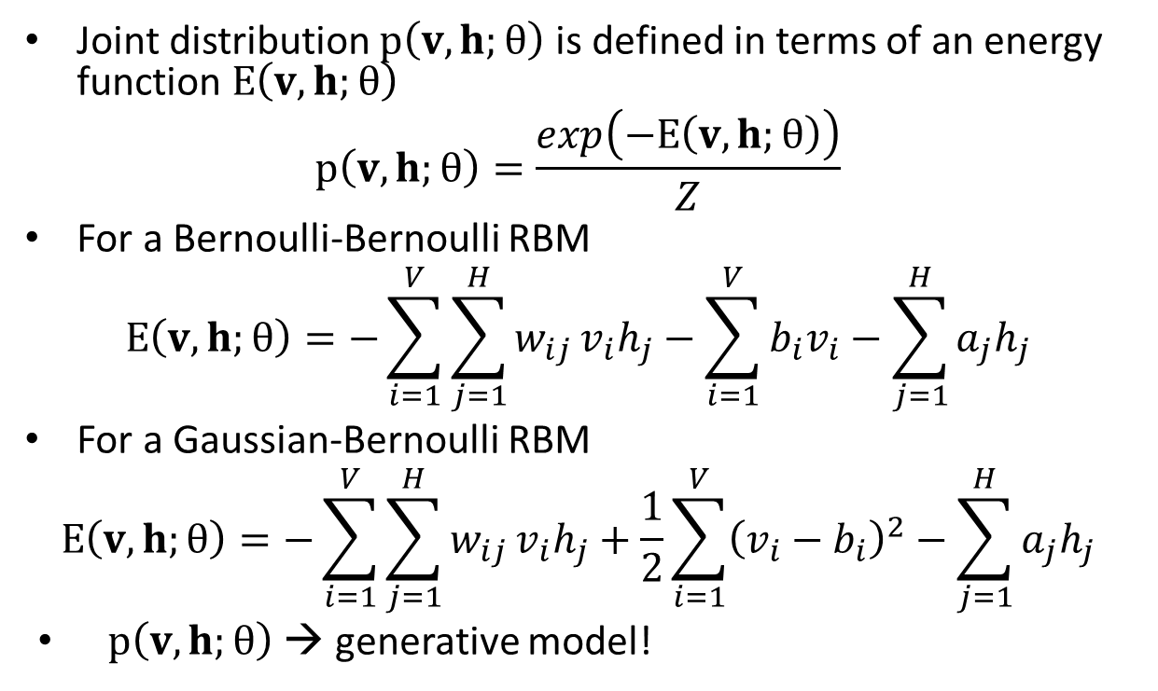
RBM: Weights → Energies → Probabilities
Joint distribution $p\left(v,h;θ\right)$ is defined in terms of an energy function $E\left(v,h;θ\right)$
$$p\left(v,h;θ\right)=\frac{exp\left(−E\left(v,h;θ\right)\right)}{Z}$$
For a Bernoulli-Bernoulli RBM
$$E\left(v,h;θ\right)=−\sum_{i=1}^{V}{\sum_{j=1}^{H}{w_{ij}}v_{i}h_{j}}−\sum_{i=1}^{V}{b_{i}v_{i}}−\sum_{j=1}^{H}{a_{j}h_{j}}$$
For a Gaussian-Bernoulli RBM
$$E\left(v,h;θ\right)=−\sum_{i=1}^{V}{\sum_{j=1}^{H}{w_{ij}}v_{i}h_{j}}+\frac{1}{2}\sum_{i=1}^{V}{{\left(v_{i}−b_{i}\right)}^{2}}−\sum_{j=1}^{H}{a_{j}h_{j}}$$
$p\left(v,h;θ\right)$ → generative model!

Slide 40
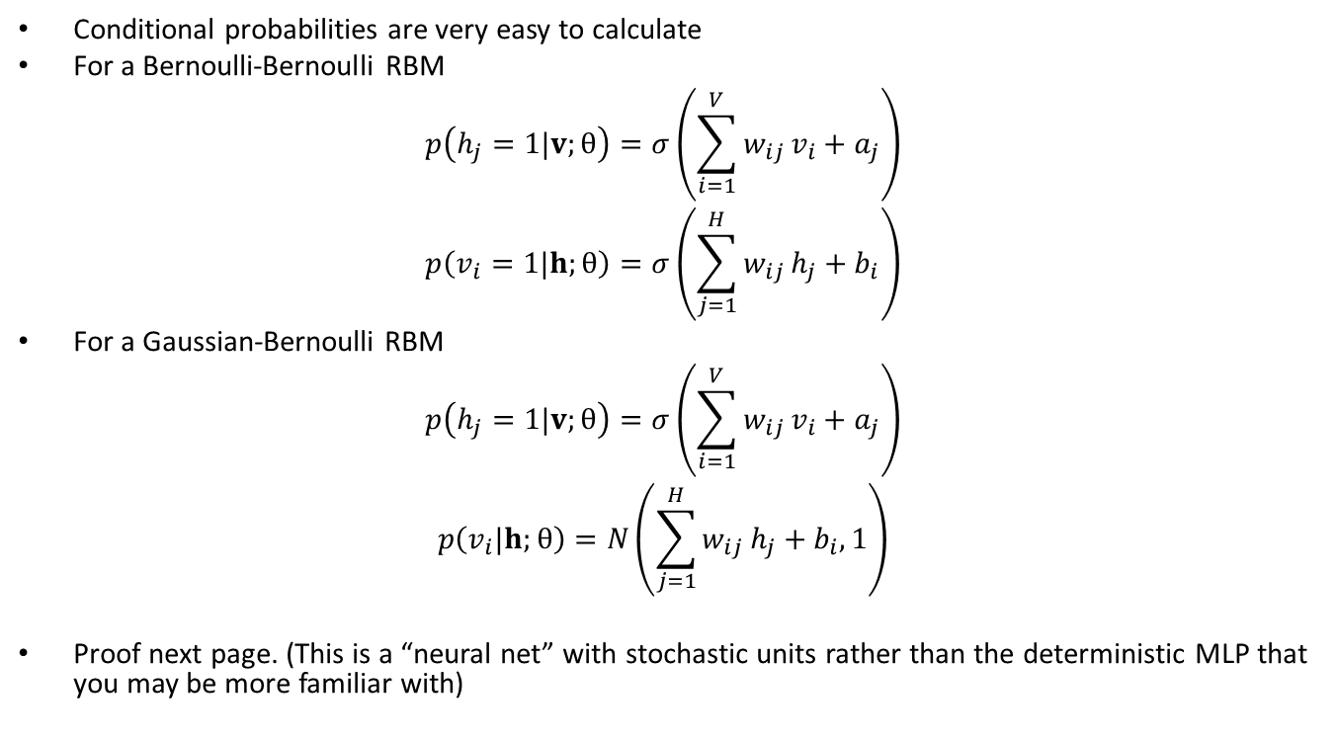
Restricted Boltzmann Machine (RBM)
Conditional probabilities are very easy to calculate
For a Bernoulli-Bernoulli RBM
$$p\left(h_{j}=1|v;θ\right)=σ\left(\sum_{i=1}^{V}{w_{ij}}v_{i}+a_{j}\right)$$
$$p\left(v_{i}=1|h;θ\right)=σ\left(\sum_{j=1}^{H}{w_{ij}}h_{j}+b_{i}\right)$$
For a Gaussian-Bernoulli RBM
$$p\left(h_{j}=1|v;θ\right)=σ\left(\sum_{i=1}^{V}{w_{ij}}v_{i}+a_{j}\right)$$
$$p\left(v_{i}|h;θ\right)=N\left(\sum_{j=1}^{H}{w_{ij}}h_{j}+b_{i}, 1\right)$$
Proof next page. (This is a “neural net” with stochastic units rather than the deterministic MLP that you may be more familiar with)
Inference
synthesis
Inference

Slide 41
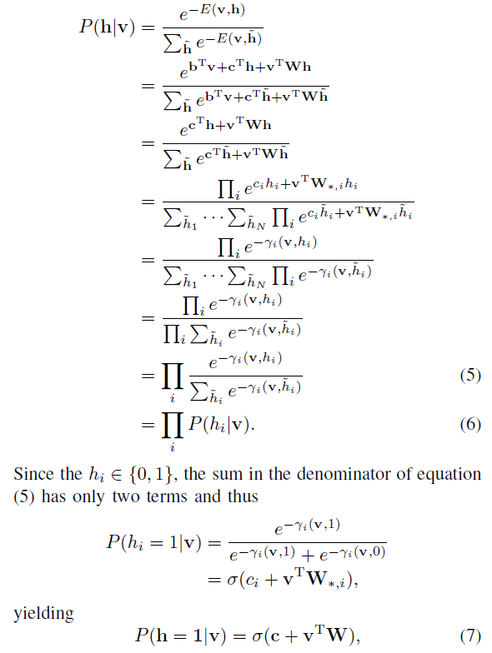

Slide 42
Maximum likelihood learning for RBM
j
j
j
j
a fantasy
i
i
i
i
t = 0 t = 1 t = 2 t = infinity
Start with a training vector on the visible units.
Then alternate between updating all the hidden units in parallel and updating all the visible units in parallel.

Slide 43
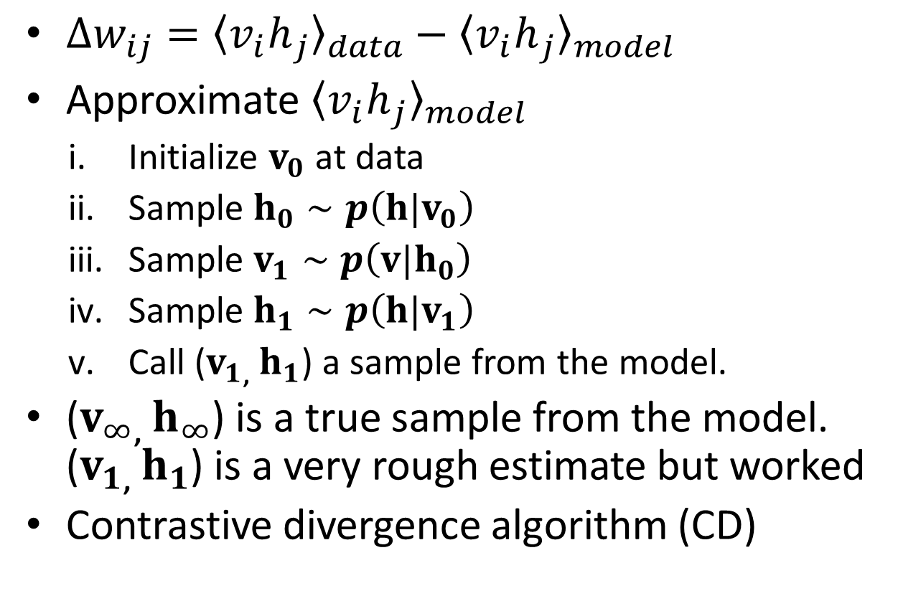
Training RBMs
$∆w_{ij}={〈{v_{i}h}_{j}〉}_{data}−{〈{v_{i}h}_{j}〉}_{model}$
Approximate ${〈{v_{i}h}_{j}〉}_{model}$
Initialize $v_{0}$ at data
Sample $h_{0}∼p\left(h|v_{0}\right)$
Sample $v_{1}∼p\left(v|h_{0}\right)$
Sample $h_{1}∼p\left(h|v_{1}\right)$
Call ($v_{1}$, $h_{1}$) a sample from the model.
($v_{∞}$, $h_{∞}$) is a true sample from the model. ($v_{1}$, $h_{1}$) is a very rough estimate but worked
Contrastive divergence algorithm (CD)

Slide 44
RBM versus GMM
Gaussian Mixture Model
Local representation
(In practice,) data vector explained by only a single Gaussian
Tend to over-fit
Bernoulli-Gaussian RBM
Distributed representation, very powerful
Product of Gaussians
Tend to under-fit

Slide 45
Building a Deep Network
This is the main reason why RBM’s are interesting (as a building block)
First train a layer of hidden units that receive input directly from the data (image, speech, coded text, etc).
Then treat the activations of hidden units (the trained “features”) as if they were “data” and learn features of features in a second hidden layer.
It can be proved that each time we add another layer of features we improve a variational lower bound on the log probability of the training data.
The proof is complicated (Hinton et al, 2006)
Based on an equivalence between an RBM and a deep directed model

Slide 46
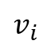
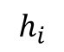
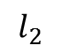


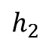
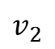
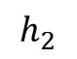
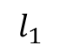


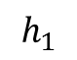
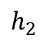
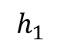
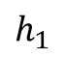
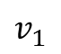

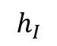



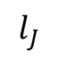

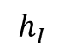
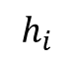

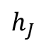
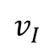

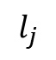
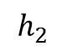
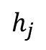
Deep Belief Net (DBN) & Deep Neural Net (DNN)
DBN: Undirected at top two layers which is an RBM; directed Bayes net (top-down) at lower layers (good for synthesis and recognition)
DNN: Multi-layer perceptron (bottom up) + unsupervised pre-training w. RBM weights (good for recognition only)
$$l_{1}$$
$$l_{2}$$
$$⋯$$
$$l_{j}$$
$$⋯$$
$$l_{J}$$
Labels
MANY Hidden Layers
MANY Hidden Layers
$$h_{1}$$
$$h_{2}$$
$$⋯$$
$$h_{i}$$
$$⋯$$
$$h_{I}$$
$$1$$
MANY Hidden Layers
$$h_{1}$$
$$h_{2}$$
$$⋯$$
$$h_{j}$$
$$⋯$$
$$h_{J}$$
$$1$$
$$h_{1}$$
$$h_{2}$$
$$⋯$$
$$h_{i}$$
$$⋯$$
$$h_{I}$$
$$1$$
$$h_{1}$$
$$h_{2}$$
$$⋯$$
$$h_{j}$$
$$⋯$$
$$h_{J}$$
$$1$$
$$h_{1}$$
$$h_{2}$$
$$⋯$$
$$h_{i}$$
$$⋯$$
$$h_{I}$$
$$1$$
$$h_{1}$$
$$h_{2}$$
$$⋯$$
$$h_{j}$$
$$⋯$$
$$h_{J}$$
$$1$$
Visible Layer
$$v_{1}$$
$$v_{2}$$
$$⋯$$
$$v_{i}$$
$$⋯$$
$$v_{I}$$
$$1$$

Slide 47
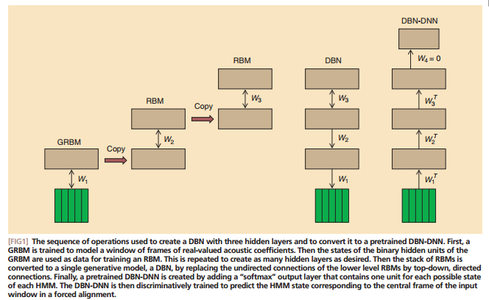
Hinton, Deng, Yu, Mohamed, Dahl. IEEE Sig. Proc. Mag. (Nov 2012)
First train a stack of three models each of which has one hidden layer. Each model in the stack treats the hidden variables of the previous model as data.
Then add outputs and train the DNN with backprop.
Then compose them into a single Deep Belief Network.

Slide 48
Quiz Questions
DBN & DNN: which one is generative? Which one is discriminative?
How can a generative model be used for recognition? (Bayes rule as for HMM speech recognition)
How does DBN do synthesis?
How does DBN do recognition?
How does DNN do recognition?
For recognition, is RBN or DNN better?
What is the difference between DBN and Dynamic Bayes Net (a.k.a. “DBN”)?

Slide 49
The Answer to Quiz Question 3:
To generate data:
Get an equilibrium sample from the top-level RBM by performing alternating Gibbs sampling for a long time.
Perform a top-down pass to get states for all the other layers.
So the lower level bottom-up connections are not part of the generative model. They are just used for inference.
h3
h2
h1
data

Slide 50
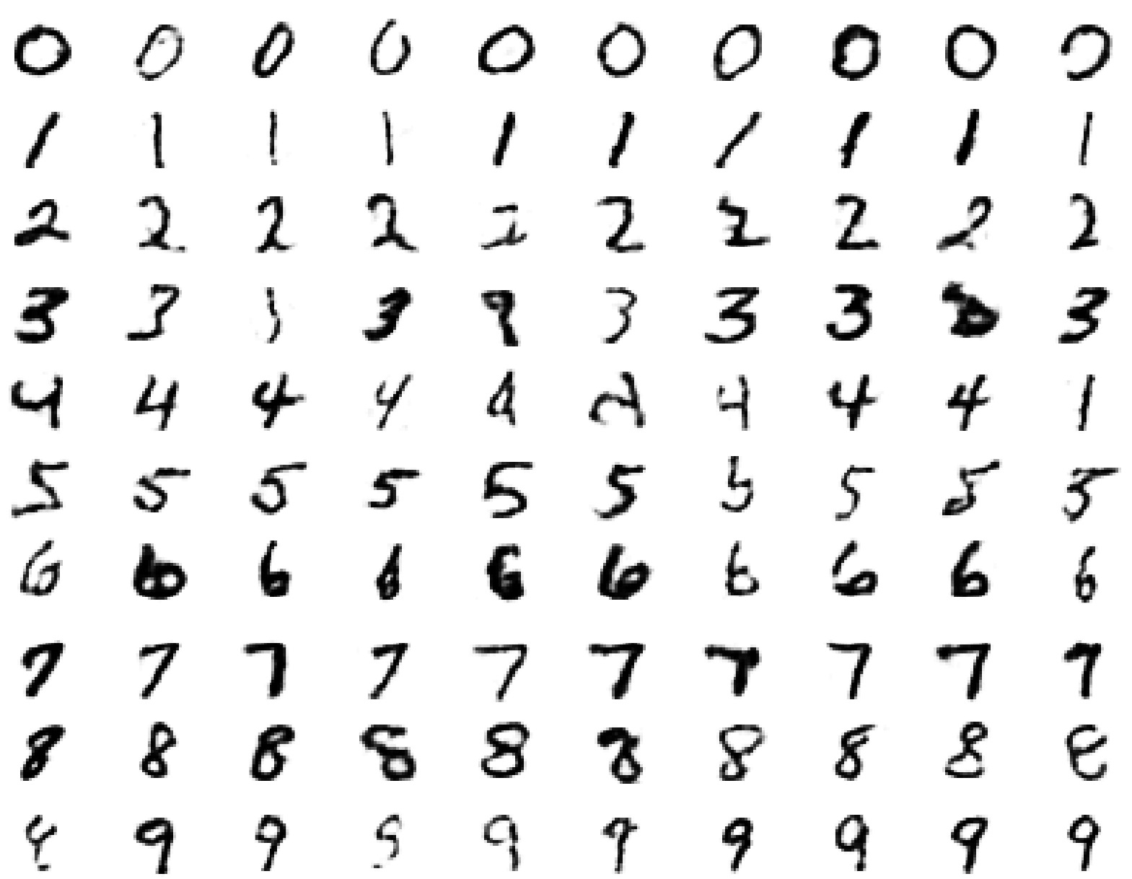
Samples generated by letting the associative memory run with one label clamped. There are 1000 iterations of alternating Gibbs sampling between samples (example from Hinton) .

Slide 51
Answer to Quiz Question 4: Example of digit/image recognition by DBN
The top two layers form an associative memory whose energy landscape models the low dimensional manifolds of the digits
The energy valleys have names
2000 top-level neurons
10 label neurons
500 neurons
The model learns to generate combinations of labels and images.
To perform recognition we start with a neutral state of the label units and do an up-pass from the image followed by a few iterations of the top-level associative memory ---> probability of that digit label; then repeat for all digit labels; then compare.
(slide modified from Hinton)
500 neurons
28 x 28 pixel image

Slide 52
DBN & DNN: Fine-tuning for discrimination
First learn one layer at a time greedily.
Then treat this as “pre-training” that finds a good initial set of weights which can be fine-tuned by a local search procedure.
For DBN: Contrastive wake-sleep (see Hinton’s)
For DNN: Back-propagation
This overcomes many of the limitations of standard backpropagation (if you do not have large labeled training data).

Slide 53
Fine Tuning DNN after pre-training: Optimization view
Stacking RBMs one layer at a time scales well to really big networks
Do not start back-propagation until sensible feature detectors are found by RBM pre-training that should already be very helpful for the discrimination task.
Back-propagation only needs to perform a local search from a sensible starting point.

Slide 54
Fine Tuning DNN after pre-training: Regularization view
Information in the pre-trained weights comes from modeling the distribution of input vectors in an “unsupervised” manner.
The input vectors generally contain a lot more information than the labels.
The precious information in the labels is only used for the final fine-tuning.
The fine-tuning only modifies the features slightly to get the category boundaries right. No need to discover “features”.
Hence less prone to overfit (unlike the old neural nets with typically random weight initialization)
This type of backpropagation works well even if most of the training data is unlabeled.
The unlabeled data is still very useful for discovering good features.

Slide 55
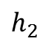
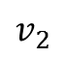

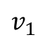


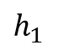
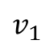
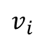
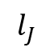
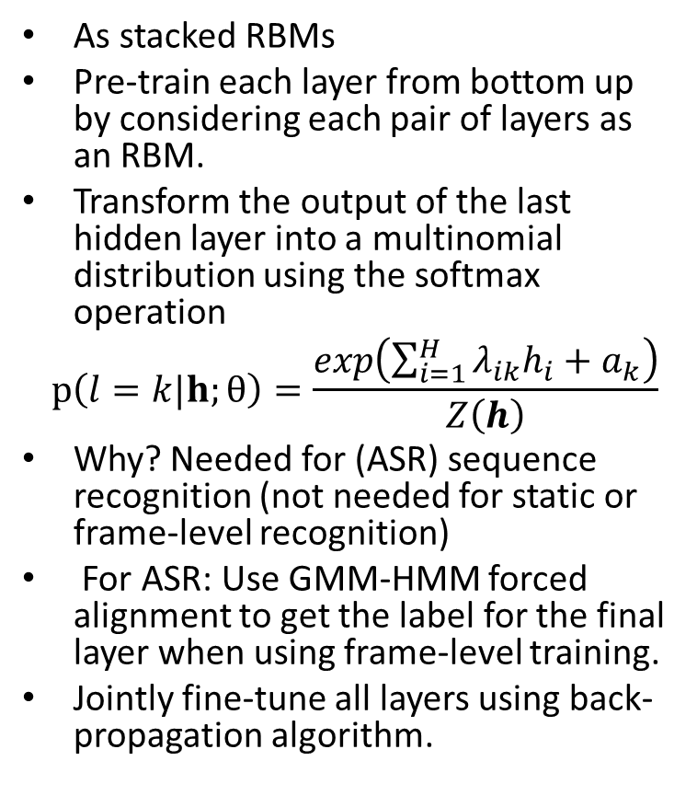


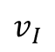


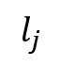

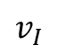
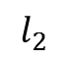
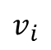
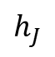


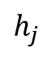
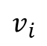



DNN with class posteriors (not DBN)
As stacked RBMs
Pre-train each layer from bottom up by considering each pair of layers as an RBM.
Transform the output of the last hidden layer into a multinomial distribution using the softmax operation
$$p\left(l=k|h;θ\right)=\frac{exp\left(\sum_{i=1}^{H}{λ_{ik}h_{i}}+a_{k}\right)}{Z\left(h\right)}$$
Why? Needed for (ASR) sequence recognition (not needed for static or frame-level recognition)
For ASR: Use GMM-HMM forced alignment to get the label for the final layer when using frame-level training.
Jointly fine-tune all layers using back-propagation algorithm.
$$l_{1}$$
$$l_{2}$$
$$⋯$$
$$l_{j}$$
$$⋯$$
$$l_{J}$$
$$v_{1}$$
$$v_{2}$$
$$⋯$$
$$v_{i}$$
$$⋯$$
$$v_{I}$$
$$1$$
$$h_{1}$$
$$h_{2}$$
$$⋯$$
$$h_{j}$$
$$⋯$$
$$h_{J}$$
$$1$$
$$v_{1}$$
$$v_{2}$$
$$⋯$$
$$v_{i}$$
$$⋯$$
$$v_{I}$$
$$1$$
$$h_{1}$$
$$h_{2}$$
$$⋯$$
$$h_{j}$$
$$⋯$$
$$h_{J}$$
$$1$$
$$v_{1}$$
$$v_{2}$$
$$⋯$$
$$v_{i}$$
$$⋯$$
$$v_{I}$$
$$1$$
$$h_{1}$$
$$h_{2}$$
$$⋯$$
$$h_{j}$$
$$⋯$$
$$h_{J}$$
$$1$$
$$v_{1}$$
$$v_{2}$$
$$⋯$$
$$v_{i}$$
$$⋯$$
$$v_{I}$$
$$1$$

Slide 56
Theoretical Insights of DBN
Restricted Boltzmann Machine (RBM) as the building block of DBN
RBM can be viewed as infinitely deep directed Bayesian/Belief network with tied weights over layers
Complementary prior (Hinton et. al. 2006)
Regularization vs. optimization
Generative vs. discriminative
Theory is still weak

Slide 57



RBM (Restricted Boltzmann Machine)
An RBM is equivalent to an infinite directed net with replicated weights that define the compatible conditional distributions: $p\left(v|h\right)$ and $p\left(h|v\right)$.
A top-down pass of the directed net is exactly equivalent to letting an RBM settle to equilibrium when nothing is clamped.
The model above a layer define a complimentary prior for that layer.
Inference in the directed net is exactly equivalent to letting an RBM settle to equilibrium starting at the data

Slide 58

DBN: Generative Mode
learns to generate combinations of labels and features
1. Run the top layer to thermal equilibrium with or without label clamped
2A. Sample from the distribution and then top-down till end
2B. Calculate p(v) and sample from it.

Slide 59

Deep Neural Network
Recognition using generative DBN is poor.
For recognition better use discriminative deep neural network, e.g., multi-layer perceptron with many layers
Training deep neural network is hard
Trick: Use DBN pretraining procedure to initialize the weights and then use backpropagation algorithm to fine tune the weights.
It can alleviate some of the problems associated with backpropagation esp. when training set is small
Empirically works well without theoretical guarantee.

Slide 60
Why this way of making a deep generative model is sensible.
The layers can be trained separately
This can be done with unlabeled data.
Inference is extremely simple in an RBM.
The latent variables are conditionally independent given the data.
There is no “explaining away.”
After composing the separate models into a single DBN, approximate inference is simple.
And it is also accurate.

Slide 61
The current wisdom on unsupervised pre-training
Pre-training achieves two things:
It makes optimization easier.
It reduces overfitting.
We now know more about how to initialize weights sensibly by hand.
So unsupervised pre-training is not required to make the optimization work.
Unsupervised pre-training is still very effective at preventing over-fitting when labeled data is scarce.
It is not needed when labeled data is abundant.
Hinton: ICASSP-2013

Slide 62
DNN Took off in Speech Recognition from MSR
Speech recognition: the first big (and real-world) success of deep learning
From MSR (initial collaboration with Hinton et al., 2009-2010) and then to the entire speech industry
Got out of “local optimum” of GMM-HMM stayed for many years
Now used by Microsoft, Google, Apple/Nuance/IBM, Baidu, IFlyTech, etc. doing voice search in in the cloud for smart phones (plus many other applications.)
A short historical review

Slide 63

Renaissance of Neural Network --- “Deep Learning,” 2006
-Geoff Hinton invented Deep Belief Networks (DBN) to make neural net learning fast and effective; Science, 2006
Pre-train each layer from bottom up
Each pair of layers is an Restricted Boltzmann Machine (RBM)
Jointly fine-tune all layers using back-propagation

Slide 64

Industry Scale Deep Learning
Pioneered at MSR, 2009
-2008 NIPS: Geoff Hinton & Li Deng reconnected
-Earlier 2009: Initial exploration of DBN/DNN at MSR (image and speech)
-Later 2009: MSR (Deng et al) & Hinton collaborated on applying DBN-DNN to speech feature coding and speech recognition
-Dec 2009: NIPS workshop
(organizers: Deng, Yu, & Hinton)

Slide 65


Slide 66
Industrial Scale Deep Learning
Continued at MSR, 2010, 2011…
-2010: slowly more people in MSR-speech joined DBN-DNN research
-July 2010: success of bottleneck feature coding using speech spectrogram; Interspeech-2010 paper Deng et al.
-August 2010: success of DNN in large-vocabulary speech recognition (voice search); paper in ICASSP-2011 (Dahl/Yu/Deng)
-Oct 2010: MSR/MSRA collaboration started on Switchboard task
-March 2011: Success in the Switchboard task by MSR/MSRA; Interspeech-2011: Seide/Yu, et al. Success of deep stacking net: Deng et al.

Slide 67

1989
1999
2011

Slide 68
1989
2011

Slide 69

DNN-HMM (replacing GMM only; longer MFCC/filter-back windows w. no transformation)
Model tied triphone states directly
Many layers of nonlinear feature transformation + SoftMax

Slide 70

CD-DNN-HMM: Architecture

Slide 71

(Shallow) GMM-HMM
Model frames of acoustic data with two stochastic processes:
A hidden Markov process to model state transition
A Gaussian mixture model to generate observations
Train with maximum likelihood criterion using EM followed by discriminative training (e.g. MPE)

Slide 72
Voice Search with DNN-HMM
First attempt in using deep models for large vocabulary speech recognition (summer 2010)
Published in ICASSP-2011 & 2012 Special issue of T-ASLP:

Slide 73

MSR Key Innovations (2009-2013)
Scale the success to large industrial speech tasks
Grew output neurons from context-independent phones (100-200) to context-dependent ones (9k-32k)
Motivated initially by saving huge MSFT investment in huge speech decoder software infrastructure (e.g. Entropic acquisition)
Extremely fast decoder
Developed novel deep learning architectures & techniques: DCN/DSN, tensor-DSN, kernel-DCN, tensor-DNN, etc.
Engineering for large systems:
Expertise in DNN and speech recognition
Close collaboration among MSRR, MSRA, & speech product teams
(Deng, Yu, Seide, Gang Li, Jinyu Li, Jui-Ting Huang, Yifan Gong, etc.)

Slide 74
Some Recent News by Reporters
DNN Research Improves Bing Voice Search (very fast decoder)
How technology can bridge language gaps: Speech-to-speech translation promises to help connect our world
Scientists See Promise in Deep-Learning Programs (NYT: speech to speech)
Microsoft Research shows a promising new breakthrough in speech translation technology
Bing Makes Voice Recognition on Windows Phone More Accurate and Twice as Fast
Microsoft revs speedier, smarter speech recognition for phones

Slide 75
Examples of Algorithm and Architecture Innovations
Samples/summary in next few slides
More details in next few days
Some analysis in ICML-2013 keynote

Slide 76


Discriminative Pre-training for DNN
Train weights with a single hidden layer using BackProp (stop early)
Insert a new hidden layer and train it using BackProp (stop early)
Continue to a fixed number of layers (stop early)
Finally, jointly fine-tune all layers till convergence (no RBM/DBN)
Yu, Deng, Seide: Discriminative pretraining of deep neural networks, patent filed Nov. 2011
Seide, Li, Yu: ASRU, 2011.

Slide 77


Deep Convex Network (DCN/DSN)
.
.
.
Example: L=3
Deng & Yu (Interspeech 2011, ICASSP-2012)
Best L=26
Interleaving linear/nonlinear layers
Convex optimization
Each image has 784 pixels
Ten classes as the output of each module (digits)
Parallel implementation (interspeech-2012; GPU free)
Works very well for MNIST, TIMIT, WSJ, and SLU (Deng,Yu, Platt: ICASSP-2012, etc.)
10
3000
10
784
3000
10
784
3000
784

Slide 78

Tensor Version of DCN/DSN (Hutchinson, Deng, & Yu, ICASSP-2012, IEEE T-PAMI, 2013)

Slide 79

Tensor Version of DNN (Yu, Deng, Seide, Interspeech-2012, T-ASLP, 2013)

Slide 80
Outline
Deep Learning
A quick Tutorial (RBM, DBN, DNN-HMM, DCN)
A brief history on how speech industry started exploring deep learning with success stories (replacing GMM so far)
Current success on speech recognition
Part I.B : Dynamic Generative Models and Learning
DBN*, HDM, HTM, segment models, etc.
A (longer) separate history and a critical review
Connecting the Dots
Linguistic hierarchy in dynamic human speech
Exploiting hierarchical dynamics in deep learning framework (to replace HMM and MFCCs as well)
Notes:
Contextual dynamics; massive parameters vs parsimonious params; constraints in RNN.

Slide 81
Deep/Dynamic Models are Natural for Speech
Hierarchical structure in human speech generation
Global concept/semantics formation
Word sequence formation / prosodic planning
Phonological encoding (phones, distinctive features)
Phonetic encoding (motor commands, articulatory targets)
Articulatory dynamics
Acoustic dynamics (clean speech)
Distorted speech
Interactions between speakers and listener/machine
Hierarchical structure in human speech perception
Cochlear nonlinear spectral analysis
Attribute/phonological-feature detection at higher level(s)
Phonemic and syllabic detection at still higher level(s)
Word and sequence detection
Syntactic analysis and semantic understanding at deeper auditory cortex

Slide 82

Production & Perception: Closed-Loop Chain
SPEAKER
LISTENER
decoded
message
Internal
model
message
ear/auditory reception
motor/articulators
Speech Acoustics in
closed-loop chain

Slide 83
(Deep) Dynamic Bayesian Net
SPEAKER
targets
articulation
message
distortion-free acoustics
distorted acoustics
motor/articulators
Speech Acoustics
distortion factors &
feedback to articulation

Slide 84

ICASSP-2004

Slide 85
Generative Modeling

Slide 86




Slide 87
(Hidden) Dynamic Models
Many types of dynamic models since 90’s
Good survey article on earlier work (Ostendorf et al. 1996)
Hidden Dynamic Models (HDM/HTM) since late 90’s
This is “deep” generative model with >2 layers
More recent work: book 2006
Pros and cons of different models
All intended to create more realistic speech models “deeper” than HMM for speech recognition
But with different assumptions on speech dynamics
How to embed such dynamic properties into the DNN framework?

Slide 88
Outline
Part I.A: Deep Learning
A quick Tutorial (RBM, DBN, DNN-HMM, DCN)
A brief history on how speech industry started exploring deep learning with success stories (replacing GMM so far)
Part I.B: Dynamic Models and Learning
DBN*, HDM, HTM, segment models, etc.
A longer, separate history and a critical review
Part I.C: Connecting the Dots
Linguistic hierarchy in dynamic human speech
Exploiting hierarchical dynamics in deep learning framework (to replace HMM and MFCCs as well)
Notes:
Contextual dynamics; massive parameters vs parsimonious params; constraints in RNN.

Slide 89
DBN (Deep) vs. DBN* (Dynamic)
DBN-DNN (2009-2012) vs. HDM/HTM (1990’s-2006)
Distributed vs. local representations
Massive vs. parsimonious parameters
Product of experts vs. mixture of experts
Generative-discriminative hybrid vs. generative models
Longer windows vs. shorter windows
A neat way of “pre-training” RNN by HDM and then “fine-tuning” RNN by backprop (non-trivial gradient derivation and computation)

Slide 90
Building Dynamics into Deep Models
(Deep) recurrent neural networks for ASR: both acoustic and language modeling
generic temporal dependency
lack of constraints provided by hidden speech dynamics
Information redundancy: long windows for each “frame”
Importance of optimization techniques (e.g. Hessian-free method)
Recursive neural net for parsing in NLP
An active and exciting research area to work on

Slide 91
Summary
Historical accounts of DBN/DBN* research in speech recognition
Speech research motivates the use of deep architectures from human speech production/perception mechanisms
GMM-HMM is a shallow architecture with GMM to link linguistic units with observations
Hierarchical/deep statistical models for speech developed in the past
trajectory model, segmental model, switching dynamic system model, hidden dynamic /trajectory model, and hybrid tandem model, etc.
Less success than expected
Beginning to understand why, based on the success of more recent successful use of Deep models in speech recognition
Importance of distributed representation, massive parameters, fast/parallel computing (GPU), product of experts.

Slide 92
Outlook
Connecting DBN/DNN (replacing GMM) and dynamic properties/models (DBN*) of speech (replacing HMM)
Deep Recurrent Neural Nets
Need to go beyond unconstrained temporal dependence (while easier to learn)
Adaptive learning (not so successful yet)
Scalable/parallel learning (e.g., DCN/DSN, T-DSN)
Applications: ASR, SLU, IR, LM, NLP, image/object recognition, ?speaker/language recognition?
Deep learning: weak in theory; strong in applications; exciting area to work on

Slide 93
PART I: Basics PART II: Modern (as of June 2013) - papers/presentations from ICASSP-2013 and ICML-2013

Slide 94

New Types of Deep Neural Network & Learning for Speech Recognition+ An Overview
Li Deng, Geoffrey Hinton, Brian Kingsbury
MSR, U. Toronto/Google, IBM
ICASSP Special Session, May 28, 2013

Slide 95



Special Session Motivations
Huge impact of deep neural nets (DNN) in speech (and vision, language, etc.)

Slide 96
Special Session Motivations
Review article (2011-2012) IEEE Sig. Proc. Mag, Nov 2012
Key factors:
Deeper network
Faster hardware
Larger network output layer
(& hidden, input layers)
Better network initialization
(not essential with big data)
Rather standard MLP
architecture
Also standard backprop
learning (1980’s)

Slide 97
Take-Away from This Special Session
New models and new learning methods
Key capabilities of DNNs in knowledge transfer, learning representations, etc.
Advances in DNNs since the SPM overview paper

Slide 98

Recent History of “Deep” Models in Speech
U Toronto’s DBN-DNN (2006-2009)
MSR’s (deep) Dyn. Bayes Net (2004-2007)
Phones/words
targets
articulation
message
distortion-free acoustics
distorted acoustics
motor/articulators
distortion factors &
feedback to articulation
Mohamed, Dahl, Hinton, NIPS-WS, 2009
(a simple “recipe”)

Slide 99
Hinton’s 2009“Recipe”

Slide 101



Deep Learning for Phone Recognition (a stunning discovery at MSR, 2009)
Error pattern A
Error pattern B

Slide 102

Deep Learning for Large-Vocabulary Speech Recognition

Slide 103
New Discoveries about the DNN “Recipe” since 2009
Pre-training not needed when a lot of labeled data are available (2010)
The recipe works well for LVCSR when DNN output units correspond to CD HMM states (2010)
Decoding alg. & infrastructure largely unchanged, enabling industry-scale speech recognition (2010-2013)
Filterbank features (closer to waveform) better than MFCCs for DNNs (opposite to GMM systems) (2011-2013)
DNN works surprisingly well for noisy speech (2012)
Fully-connected DNN can be modified to include “convolutional” layers to handle speech variability (2012-2013)
DNN highly effective for multi-task/transfer learning (e.g. multilingual ASR, 2012-2013)
DNN effective for applications beyond ASR.

Slide 104

Five Technical Papers in Our Special Session
RECENT ADVANCES IN DEEP LEARNING FOR SPEECH
RESEARCH AT MICROSOFT
IMPROVING DEEP NEURAL NETWORKS FOR LVCSR
USING RECTIFIED LINEAR UNITS AND DROPOUT
DEEP CONVOLUTIONAL NEURAL NETWORKS
FOR LVCSR
MULTILINGUAL ACOUSTIC MODELS USING DISTRIBUTED
DEEP NEURAL NETWORKS
ADVANCES IN OPTIMIZING RECURRENT NETWORKS

Slide 105
Themes in the Session

Slide 106
Themes: Better Inputs

Slide 107
Themes: Nonlinearities

Slide 108

Themes: Architectures

Slide 109

Themes: Optimization

Slide 110

Themes: Regularization

Slide 111

Themes: Hyperparameters

Slide 112

Themes: Multi-task Learning

Slide 113
Thank You
Stop mooching, moocher -_- !!! -Lloyd

Slide 114

Recent Advances in Deep Learning for Speech Research at Microsoft
Li Deng, Jinyu Li, Jui-Ting Huang, Kaisheng Yao, Dong Yu, Frank Seide, Mike Seltzer, Geoff Zweig, Xiaodong He, Jason Williams, Yifan Gong, Alex Acero
ICASSP Special Session, May 28, 2013

Slide 115
Outline
Advances in deep learning for features/ representations
Advances in deep learning for models/ architectures
Systems and applications in acoustic modeling, language modeling, dialogue, (and information retrieval/search)

Slide 116
Learning Features/Representations
Advances in deep learning for features/ representations
Advances in deep learning for models/ architectures
Systems and applications in acoustic modeling, language modeling, dialogue, (and information retrieval/search)

Slide 117
Scientists See Promise in Deep-Learning Programs
John Markoff
November 23, 2012
Notes:
You may have seen this front page article in the NY Times last month, on the subject of “deep learning”, also referred to as “deep neural networks” or simply “deep networks”. It featured an interview with Rick Rashid and this photo of a demonstration Rick gave in China in October.
[start the video]
This was a real-time speech-to-speech translation demo, with Rick speaking freely in English and then a computer rendering his speech into Mandarin, and doing so in Rick’s own voice. This demo is something that we’ve tried to set up for a couple of years but frankly was never robust enough for a live showing. But this year that all changed, because of some remarkable advances in speech processing.
Just to make this more vivid, I’d like to ask Rick to say a few words. [start live demo now]

Slide 118



Speech Recognition Progress:
--- gleaned from NIST evaluations
After no improvement for 10+ years by the research community…
…MSR used deep learning to reduce error rate from ~23% to ~13% on SWBD (and under 7% for Rick Rashid’s demo)!
Notes:
These advances have been achieved through the application of deep neural networks. We will explain a little bit about how DNNs work and why they might be important, but first let’s take a look at the stunning impact on speech recognition.
The US government has been funding R&D in speech recognition for over 25 years, and as part of its research programs conducts tests of the effectiveness of the best systems. This graph shows the results of these tests, from 1988 to 2011, with the measure of effectiveness being the Word Error Rate (WER). In the early years, the best speech systems worked only in very narrow domains, such as air travel planning. While narrow, very good performance could be achieved, on par with human capability.
But in open-domain situations, such as meeting transcription and television news captioning, the results have not been so good. Consider the very important Switchboard benchmark, which today is the standard used by the research community. In the late 1990’s there was good progress, but for the past decade this plateaued and in all systems the research showed essentially no progress.
In joint research with the University of Toronto, by applying deep learning to speech recognition we achieved last year an astounding improvement in error rate. This made all the difference for the demo in China. In fact, for Rick’s speech, the speech recognition system exhibited an error rate of less than 7%!

Slide 119
Back to Primitive Spectral Features
Philosophy of deep learning:
Learning representations automatically instead of manually engineering/design them (e.g., MFCC, PLP)
DNN capability in representing correlated feature dimensions
→ eliminate cosine transform in MFCC in favor of filterbanks in spectral domain

Slide 120
Back to Primitive Spectral Features
Philosophy of deep learning:
Learning representations automatically instead of manually engineering/design them (e.g., MFCC, PLP)
DNN capability in representing correlated feature dimensions
→ eliminate cosine transform in MFCC in favor of filterbanks and spectrograms in the spectral domain

Slide 121
In early 2010, we discovered:
For deep autoencoding of speech features:
Both spectrogram/filterbank features are better than MFCCs
Better to use spectrogram features than filterbanks
“Better” in terms of coding efficiency (i.e., errors/energy)

Slide 122
LVCSR Using Spectral Features
LVCSR Systems | Word error rate
Best GMM-HMM (MFCCs; fMPE+BMMI) | 34.7%
DNN (MFCCs) | 31.6%
DNN (Spectrogram --- 256 log FFT bins) | 32.3%
DNN (29 log filter-banks) | 30.1%
DNN (40 log filter-banks) | 29.9%
Filterbanks > MFCC > Spectrograms
Not quite consistent with deep autoencoder results
Further research: regularization, online feature normalization at sentence level, etc.

Slide 123


Learning Multi-Task Features
Mixed-Band DNN architecture:
Multilingual DNN architecture:

Slide 124

Shared Hidden Layers with Language-Specific Output Layers

Slide 125

Learning Multi-Task Features
English words, with some errors
or French words
or Chinese words
with fewer errors
8KHz waveforms
16KHz waveforms
Training
Runtime
English training data
French training data
Chinese training data
8Khz or 16KHz
English
speech input
or French
or Chinese
Notes:
Another important characteristic of DNNs is that they preserve some key features of our best machine learning algorithms. For example, DNNs show excellent performance in multiple tasks. If you take a DNN that has been trained on English, and then train it on French and Chinese, amazingly the performance of the DNN on English actually improves! Similarly, the same DNN then trained on 8KHz waveforms (in addition to 16KHz waveforms) shows better performance on both 8Khz and 16Khz waveforms.

Slide 126
Multi-Band ASR Summary Results
Table 2: DNN performance on wideband and narrowband test sets (a multitask-learning setup) using mixed-bandwidth training data.
Practical Goal: exploit narrowband labeled data from earlier telephone-based applications
Training Data | Test WER (Wideband) | Test WER (Narrowband)
Wideband only | 30.0% | 71.2%
Narrowband only | - | 29.0%
Wideband+Narrowband | 28.3% | 29.3%

Slide 127
Multilingual ASR Summary Results
Table 2: DNN performance on wideband and narrowband test sets (a multitask-learning setup) using mixed-bandwidth training data.
Speech Recognizers | WER on ENU
DNN trained with only ENU data | 30.9%
+FRA, retrain all layers with ENU | 30.6%
or +FRA, retrain the top layer with ENU | 27.3%
or +FRA+ DEU+ ESP+ITA, retrain top layer | 25.3%

Slide 128
Deep Convolutional Net w. Spectral Features
Table 2: DNN performance on wideband and narrowband test sets (a multitask-learning setup) using mixed-bandwidth training data.
“Spatial” (freq-domain) invariance of speech due to vocal-tract-length differences across speakers
Convolution/pooling makes sense for
spectral features, not MFCC
“spatial” dimension, not (pure) temporal dimension
Excellent results on TIMIT:
Disastrous when MFCC is used for convolutional net over “spatial” dimension

Slide 129
Noise Robust DNN Features
Beating state-of-the-art WER results on Aurora4 task (medium vocabulary task based on WSJ0)
DNN: not yet exploited explicit noise compensation algorithm
DNN: no multi-pass decoding allowing for adaptation
ASR Word Error Rate % for Autora4:

Slide 130
DNN “Model” Adaptation
Table 2: DNN performance on wideband and narrowband test sets (a multitask-learning setup) using mixed-bandwidth training data.
Speech Recognition Systems | WER
GMM-HMM | 43.6%
DNN | 34.1%
DNN + AdaptSoftMax (SGD) | 29.4%
DNN + fDLR (SGD) | 28.5%

Slide 131

New “Model” Architecture: Recurrent Net
Table 2: DNN performance on wideband and narrowband test sets (a multitask-learning setup) using mixed-bandwidth training data.
For language modeling application
Exploit context dependency (side channel information) in RNN
Side channel consists of slowly varying LSA vectors of preceding text
Evaluation on Penn Treebank data
Baseline (KN 5-gram LM w. cache)
- perplexity= 126
RNN w. side channel
- perplexity= 110
(lowest single-model perplexity for this data)

Slide 132
Deep Learning for Dialogue State Tracking
Table 2: DNN performance on wideband and narrowband test sets (a multitask-learning setup) using mixed-bandwidth training data.
.
.
.
Fertile area with preliminary exploration
Use of a new architecture: Deep Stacking Net (Deng & Yu, 2010)
Interleave linear/nonlinear layers
Exploit closed-form constraints among network’s weights
Much easier to learn than DNN
Naturally amenable to parallel training
(Largely) convex optimization
Extended to tensor and kernel versions
Works very well for MNIST, TIMIT, WSJ, SLU, and IR ranking (Deng, He, Gao: ICASSP 2013)
Here we show a more recent application to state tracking task in spoken dialogue systems.
Y3
H3
Y2
X
H2
Y1
X
H1
X

Slide 133
Dialogue State Tracking Example (Jason Williams)
Prob [ CorrectUserGoals_t | DialogueHistory_{1,2,…,t-1}, UserInfo_{1,2,…,t-1} ]
Tracker inputs
Tracker output
SLU output + confidence
Dialog state hyps
Distribution over dialog state hyps
System output
User speech
Per-hypothesis features
General features
Hello, which bus route?
sixty one c
61B 0.4
61B
Observed-count: 1
Latest-conf-score: 0.4
Confirmed: no
…
QuestionType: Ask
Times-asked: 1
Times-confirmed: 0
Hyp-count: 3
61B
61D 0.3
61D
Observed-count: 1
Latest-conf-score: 0.4
Confirmed: no
…
61D
61C 0.1
61C
Observed-count: 1
Latest-confidence: 0.1
Confirmed: no
61C
Rest
Sorry, which bus route?
sixty one c
63 0.5
63
Observed-count: 1
Latest-conf-score: 0.4
Confirmed: no
…
QuestionType: Ask
Times-asked: 2
Times-confirmed: 0
Hyp-count: 5
61B
53 0.4
53
Observed-count: 1
Latest-conf-score: 0.4
Confirmed: no
…
61D
61C 0.2
61B
Observed-count: 1
Latest-conf-score: 0.4
Confirmed: no
…
61C
61D
Observed-count: 1
Latest-conf-score: 0.4
Confirmed: no
…
63
61C
Observed-count: 2
Latest-confidence: 0.2
Confirmed: no
53
At a given turn, there are G dialog state hypotheses to score. At this turn, G=5.
Rest
Sixty one c, is that right?
yes
YES 0.9
63
Observed-count: 1
Latest-conf-score: 0.4
Confirmed: no
…
QuestionType: Confirm
Times-asked: 2
Times-confirmed: 1
Hyp-count: 5
61B
53
Observed-count: 1
Latest-conf-score: 0.4
Confirmed: no
…
61D
61B
Observed-count: 1
Latest-conf-score: 0.4
Confirmed: no
…
61C
Each hypothesis is described by M features in each turn. In this example, M=3.
61D
Observed-count: 1
Latest-conf-score: 0.4
Confirmed: no
…
63
61C
Observed-count: 2
Latest-confidence: 0.2
Confirmed: yes
Each turn also has K features that describe general dialog context. In this example, K=4.
53
Rest

Slide 134
DSN Results for Dialogue State Tracking
Table 2: DNN performance on wideband and narrowband test sets (a multitask-learning setup) using mixed-bandwidth training data.
Task: Dialog state tracking (defined in Spoken Dialogue Challenge 2010)
Strong interactions among features → strength of deep networks
Can be framed as a multiple binary classification problem
Baseline: carefully tuned, highly optimized Max Entropy classifier (J. Williams)
Deep Stacking Nets (slightly tuned) achieve similar accuracy% for all 5 slots:
 | State of the Art baseline | Deep Stacking Networks
Bus route | 58.0% | 58.1%
Origin location | 56.4% | 57.1%
Destination location | 66.5% | 65.4%
Date | 83.9% | 84.6%
Time | 63.1% | 62.5%

Slide 135
Conclusions
Deep learning is a powerful technology
Automatic learning of representations
Multi-task learning
Factorizing/disentangling multiple causes of variations
Future directions
More effective deep architectures and learning algms
Scale deep mode training with bigger data
Extend applications of deep learning: acoustic models, language models, dialogue, end-2-end language understanding & translation, IR/search, synthesis, music processing, etc.

Slide 136
Thank You

Slide 137
A Deep Convolutional Neural Net Using Heterogeneous Pooling to Tradeoff Acoustic Invariance w. Phonetic Distinction
Li Deng, Ossama Abdel-Hamid, and Dong Yu
Microsoft Research, Redmond
York University, Toronto
ICASSP, May 28, 2013

Slide 138

Background: Convolutional Nets (CNN)
LeCun et al. 90’s
Convolution layer (w. tying weights): a.k.s. “time/spatial”-invariant FIR filter
Gives maps of replicated features; neural activities “equivariant” to translation
Pooling layer (max of neighboring units in conv layer): Data reduction & some degree of invariance.
2D deep-CNN: State of the art in object recognition (Krizhevsky et al., 2012; LeCun et al.; Ciresan et al.)

Slide 139
Background: Convolutional Nets (CNN)
Difficulties of CNN:
2D Images: Information lost about the precise positions of parts → object confusion
2D Speech spectrogram: spectral-temporal information lost about phonetic distinction
E.g. 1-D CNN along freq axis (Abdel-Hamid et al., 2012): (TDNN & TF-trajectory CNN)
local weight sharing + max pooling over a range→ invariance to freq shift
(VTL normalization)
But if freq range too small → not enough VTL normalization (acoustic invariance)
too large → formant patterns of a sound shift → phone confusion
Solutions for image recognition: (tried some for speech, no clear success)
Transforming autoencoder (Hinton et al., 2011)
Tiled CNN (Le et al., 2012)
Deconvolutional nets (Zeiler et al., 2011)
A good solution for speech recognition is surprisingly simple

Slide 140
Main Ideas of This Paper
Bring “confusion” into designing CNN intended for “invariance”
Exploit the knowledge of how increasing the degree of invariance (to shift along frequency-axis) may reduce phonetic discrimination
Examine/predict how the pooling size (i.e. range of freq-shift invariance) affects phonetic classification errors
Theoretic guidance possible; e.g.
Phonetic reduction (in casual, conversation speech) shrinks formant space →tradeoff towards “distinction” from “invariance”→ smaller pooling size
Use of many feature maps (afforded by CNN weight tying)
Different pooling sizes (heterogeneous pooling) for different feature maps
Design and use a distribution of pooling sizes and randomly sample it.
Special case: use a fixed pooling size, optimized by validation or predicted by acoustic-phonetic “theory” (consistent for TIMIT; not as good as HP)

Slide 141

CNN with a Fixed Pooling Size (a special case of HP-CNN w. P=3)
P=3
P=3
(limited weight sharing)

Slide 142



HP-CNN [P_{1,} N₁ P_{2,} N_{2 … ,} P_{m,} N_{m}]
P1=2; P2=3
…………
…N1…
Pooling size P1
P1=2
…N1…
Pooling size P2
…N2…
…N2…
P2=3
…………
…………

Slide 143
Regularizing HP-CNN with “Dropout”
A variant of the Dropout method for DNN (Hinton et al., 2012)
Dropout in both conv and pooling layers of CNN is helpful, in addition to fully-connected DNN layers
Dropout in the input layer (filterbanks) is not helpful
In TIMIT, for CNN w. N=100 feature maps, and DNN hid=2000, the best dropout rate=0.2
With dropout rate=0.5 & DNN hid=5000, error rate increases

Slide 144
Standard TIMIT Task: Core Testset Results
Table 2: DNN performance on wideband and narrowband test sets (a multitask-learning setup) using mixed-bandwidth training data.
Systems | Phone Error Rate
DNN (fully-connected 5 layers) | 22.3%
CNN-DNN; P=1 (2 CNN & 3 DNN layers) | 21.8%
CNN-DNN; P=12 | 20.8%
CNN-DNN; P=6 (fixed P, optimal) | 20.4%
CNN-DNN; P=6 (add dropout) | 19.9%
CNN-DNN; P=1:m (HP, m=12) | 19.3%
CNN-DNN; above (add dropout) | 18.7%
CNN-DNN; P=1 → equivariance: 21.8% > 20.4% (invariance w. fixed, optimal pooling size=6)
CNN-DNN; P=1:12 → Heterogeneous pooling: 19.3% < 20.4%
Dropout is always helpful (thanks Geoff!): 18.7% < 19.3% ; 19.9% < 20.4%
18.7% WAS the record low error rate on this standard task (until this morning by LSTM-RNN)

Slide 145

Training Criterion: Cross-Entropy

Slide 146

Effects of Training Epochs (Time)
Each training epoch (1.12M frames in TIMIT)
→ 2 hrs of CPU time on my PC (no GPU)
% Accuracy for dev and core test sets
% Frame error rate for training set

Slide 147

Confusion Matrix (Hresults)

Slide 148

Recognition Error Breakdown
Percentage Phone Errors for Each of 39 Classes
Comparing five different phone recognizers: Effects of HP and dropout

Slide 149
HP-CNN for Large Vocabulary Speech Recognition
Table 2: DNN performance on wideband and narrowband test sets (a multitask-learning setup) using mixed-bandwidth training data.
On a voice search task
Dozens of hours of labeled training data
Not yet optimized the single fixed pooling size
No change (yet) from the TIMIT system: m=12, N=104, N1, N2, N3, N4, N5, etc.
Systems | Word Error Rate
DNN baseline (fully-connected 5 layers) | 32.4%
CNN-DNN; P=1 (2 CNN & 3 DNN layers) | 32.0%
CNN-DNN; P=1:m (HP, m=12) same distribution as in TIMIT experiment | 30.1%

Slide 150
Conclusions
Effectiveness of convolution/pooling in image recognition can be ported to speech recognition
Esp. when speech-specific properties incorporated
Bring “confusion” into designing CNN intended for “invariance”
Tradeoffs can be made by adjusting pooling size in CNN
Optimizing (a single) pooling size provides desirable tradeoffs
A much better way is to use varying pooling sizes for different feature maps (hence HP)→ record-low TIMIT error rate
HP-CNN of this paper is limited to convolution along freq-axis
Can be extended to spectro-temporal patches in spectrograms
Analogy: Object parts (image) ←→ formant trajectories (speech)
This is exciting time to integrate speech knowledge into deep learning models

Slide 151
Thank You

Slide 152
Static, ∆, ∆∆
Full Weight Sharing (Standard)
Max Pooling
…
…
Max Pooling
Share same weights
PER: 21.6% with fs:8, ps:6, shift:3, 200 Maps

Slide 153
Limited Weight Sharing
Max Pooling
…84…
…84…
Max Pooling
Share same weights
PER:
20.86% (W/O energy); 20.51% (W. energy) (20.03% in: Abdel-Hamid et. al.: ICASSP 2012)

Slide 154

Time Domain Convolution
Max Pooling
…
…
Max Pooling
(Similar work has been done by Lee/Ng for
unsupervised features learning of speech;
Time-delay NN)

Slide 155
Combined Time-Frequency Convolution
Max Pooling
…
…
Max Pooling
Share same weights

Slide 156
Deep Stacking Networks for Information Retrieval
Li Deng, Xiaodong He, and Jianfeng Gao
Microsoft Research, Redmond
ICASSP, May 30, 2013

Slide 157
Outline
Motivation: deep learning for Information Retrieval (IR)
Learning to rank
Semantic feature extraction for ranking
Deep Stacking Net (DSN)
Basic modular architectures
Novel discriminative learning algorithm
Applying DSN for IR --- learning to rank
Formulating IR as a classification problem
Special role of regularization
Experiments
IR task, data sets, and features
Relationship between NDCG score & classification error rate
NDCG results on an IR task (Ads selection)

Slide 158
Background of IR
Goal of IR: ranking text documents (D) for a query (Q)
Common methods:
Lexical matching: suffers from text discrepancy btwn Q and D (e.g. vocabulary, word usage, expression style, etc.)
E.g., TF-IDF weighted vector space model
Semantic matching: to bridge lexical gaps btw Q and D
E.g., Latent Semantic Analysis (LSA), PLSA, LDA, etc.
Learning Q-D matching using clickthrough data
E.g., translation models, bilingual topic models etc.
These linear models suffer from restricted expressive power

Slide 159
Deep Learning for IR
Multilayers of nonlinearities
Greater expressive power
Better able to capture semantic contents in Q and D
E.g., semantic hashing (Hinton et al, 2007)
More effective use of supervised clickthrough data
Use of (labeled) clickthrough data for IR ranking
Shallow linear models: Gao et al., 2010;2011
Shallow nonlinear models: Burges et al., 2005;2006

Slide 160
Deep Stacking Net (DSN)
Table 2: DNN performance on wideband and narrowband test sets (a multitask-learning setup) using mixed-bandwidth training data.
.
.
.
Deep Stacking Nets (Deng & Yu, Interspeech’10; Deng, Yu, Platt, ICASSP’12)
Interleave linear/nonlinear layers
Exploit closed-form constraints among network’s weights
Much easier to learn than DNN
Naturally amenable to parallel training
(Largely) convex optimization
Extended to tensor version (Hutchinson et al, ICASSP’12, TPAMI-2013)
Extended to kernel version (Deng et al, SLT’12)
Works very well for MNIST, TIMIT, WSJ, SLU
This paper: a more recent application to IR ranking
Y3
H3
Y2
X
H2
Y1
X
H1
X

Slide 161
Learning DSN Weights --- Main Ideas
Learn weight matrices U and W in individual modules separately.
Given W and linear output layer, U can be expressed as explicit nonlinear function of W.
This nonlinear function is used as the constraint in solving nonlinear least square for learning W.
Initializing W with RBM (bottom layer)
For higher layers, part of W is initialized with the optimized W from the immediately lower layer and part of it with random numbers

Slide 162



Learning DSN Weights --- Single Module
$$E=\frac{1}{2}\sum_{n}{{||y}_{n}−}t_{n}{||}^{2}, where{ y}_{n}=U^{T}h_{n}=U^{T}σ\left(W^{T}x_{n}\right)=G_{n}(U, W)$$
$\frac{∂E}{∂U}=2H{\left(U^{T}H−T\right)}^{T}$ → $U={\left({HH}^{T}\right)}^{−1}HT^{T}=F(W)$, where $h_{n}=σ\left(W^{T}x_{n}\right)$
$E=\frac{1}{2}\sum_{n}{||G_{n}(U, W)−}t_{n}{||}^{2},$subject to U$=F(W)$,
Y
U
Use of Lagrange multiplier method:
H
$E=\frac{1}{2}\sum_{n}{||G_{n}(U, W)−}t_{n}{||}^{2}+λ ||$U$−F\left(W\right)||$
W
to learn W and then U → no longer backpropagation
X
Advantages found:
--- less noise in gradient than using chain rule ignoring explicit constraint U$=F(W)$
--- batch learning is effective, aiding parallel training

Slide 163
Experimental Evaluation
IR task
Sponsored Search: retrieve and rank relevant ads given a query
Data sets
Training: 189K query–ads pairs
Testing: 58K query–ads pairs
Features to DSN
A total of 160 features in two categories
Text features: TF-IDF, word overlap, length, etc.
User click features: clickthrough, clicked queries, etc.
State-of-the-art baseline system (Burges et al. 2006)
LambdaRank, a single-hidden-layer neural network
Trained to maximize (a smoothed approximation of) NDCG via heuristic lambda-function

Slide 164

Evaluation Metric
Metric: Normalized Discounted Cumulative Gain (NDCG)
DCG at rank $p$ = $re{levance}_{1}+\sum_{i=2}^{p}{\frac{re{levance}_{i}}{\log_{2}{i}}}$; $re{levance}_{i}:$ human label of doc$i$, scale 0-4
IDCG: Ideal DCG, DCG score when assuming docs are ranked by human label
NDCG = DCG/ IDCG
1 NDCG pt (0.01) in our setting is statistically significant

Slide 165
NDCG Results
IR Quality measures (NDCG) for the DSN System vs. Baseline
IR Systems | NDCG@1 | NDCG@3 | NDCG@10
LambdaRank | 0.331 | 0.347 | 0.382
DSN system | 0.359 | 0.366 | 0.402

Slide 166
Analysis
Relationship between classification error rates and NDCG@1 measure)
Observations:
Correlation is clearly evidenced for NDCG1 < 0.35
Weaker correlation in the high IR-quality region, i.e., NDCG1 > 0.35
Implication:
Due to the inconsistency between the training objective and the IR-quality measure
It is desirable to train the model to optimize the end-to-end IR quality directly

Slide 167
Learning Curves

Slide 168
Conclusions
First study on the use of deep learning techniques for learning-to-rank in IR problems
Significantly better than shallow neural network
Model trained by MSE
Generally correlated well with the NDCG as the IR quality measure
But weaker correlation in the region of high IR quality
Deep learning using end-to-end IR-relevant metric is a key future direction

Slide 169



Thanks to Vincent for the permission of using his slides in this course & discussions/corrections
of information in some slides

Slide 170
Thank You

Slide 171
Selected References (updated, 2013)
Abdel-Hamid, O., Mohamed, A., Jiang, H., and G. Penn, “Applying convolutional neural networks concepts to hybrid NN-HMM model for speech recognition,” Proc. ICASSP, 2012.
Arel, I., Rose, C., and Karnowski, T. “Deep Machine Learning - A New Frontier in Artificial Intelligence,” IEEE Computational Intelligence Mag., Nov., 2010.
Baker, J., Deng, L., Glass, J., Khudanpur, S., Lee, C.-H., Morgan, N., and O’Shaughnessy, D. “Research developments and directions in speech recognition and understanding,” IEEE Sig. Proc. Mag., vol. 26, no. 3, May 2009, pp. 75-80.
Baker, J., Deng, L., Glass, J., Khudanpur, S., Lee, C.-H., Morgan, N., and O’Shaughnessy, D. “Updated MINS report on speech recognition and understanding,” IEEE Sig. Proc. Mag., vol. 26, no. 4, July 2009a.
Bengio, Y., Boulanger, N., and Pascanu. R. “Advances in optimizing recurrent networks,” Proc. ICASSP, 2013.
Bengio, Y., Courville, A., and Vincent, P. “Representation learning: A review and new perspectives,” IEEE Trans. PAMI, 2013a.
Bengio, Y. “Learning deep architectures for AI,” in Foundations and Trends in Machine Learning, Vol. 2, No. 1, 2009, pp. 1-127.
Bengio, Y., Ducharme, R., Vincent, P. and Jauvin, C. “A neural probabilistic language model,” Proc. NIPS, 2000, pp. 933-938.
Bengio, Y., De Mori, R., Flammia, G. and Kompe, F. “Global optimization of a neural network—Hidden Markov model hybrid,” in Proc. Eurospeech, 1991.
Bergstra, J. and Bengio, Y. “Random search for hyper-parameter optimization,” J. Machine Learning Research,” Vol. 3, pp. 281-305, 2012.
Bottou, L. and LeCun. Y. “Large scale online learning,” Proc. NIPS, 2004.
Bilmes, J. “Dynamic graphical models,” IEEE Signal Processing Mag., vol. 33, pp. 29–42, 2010.
Bilmes, J. and Bartels, C. “Graphical model architectures for speech recognition,” IEEE Signal Processing Mag., vol. 22, pp. 89–100, 2005.
Bourlard, H. and Morgan, N., Connectionist Speech Recognition: A Hybrid Approach, Norwell, MA: Kluwer, 1993.
Bouvrie, J. “Hierarchical Learning: Theory with Applications in Speech and Vision,” Ph.D. thesis, MIT, 2009.
Bridle, J., L. Deng, J. Picone, H. Richards, J. Ma, T. Kamm, M. Schuster, S. Pike, and R. Reagan, “An investigation of segmental hidden dynamic models of speech coarticulation for automatic speech recognition,” Final Report for 1998 Workshop on Language Engineering, CLSP, Johns Hopkins, 1998.
Caruana, R. “Multitask Learning,” Machine Learning, Vol. 28, pp. 41-75, Kluwer Academic Publishers, 1997.
Cho, Y. and Saul L. “Kernel methods for deep learning,” Proc. NIPS, pp. 342–350, 2009.
Ciresan, D., Giusti, A., Gambardella, L., and Schmidhuber, J. “Deep neural networks segment neuronal membranes in electron microscopy images,” Proc. NIPS, 2012.
Cohen, W. and R. V. de Carvalho. “Stacked sequential learning,” Proc. IJCAI, pp. 671–676, 2005.
Collobert, R. “Deep learning for efficient discriminative parsing,” Proc. NIPS Workshop on Deep Learning and Unsupervised Feature Learning, 2010.
Collobert, R. and Weston J. “A unified architecture for natural language processing: Deep neural networks with multitask learning,” Proc. ICML, 2008.
Collobert, R., Weston, J., Bottou, L., Karlen, M., Kavukcuoglu, K., and Kuksa, P. “Natural language processing (almost) from scratch,” J. Machine Learning Research, Vo. 12, pp. 2493-2537, 2011.

Slide 172
Selected References
Dahl, G., Yu, D., Deng, L., and Acero, A. “Context-dependent DBN-HMMs in large vocabulary continuous speech recognition,” Proc. ICASSP, 2011.
Dahl, G., Yu, D., Deng, L., and Acero, A. “Context-dependent, pre-trained deep neural networks for large vocabulary speech recognition,” IEEE Trans. Audio, Speech, & Language Proc., Vol. 20 (1), pp. 30-42, January 2012.
Dahl, G., Ranzato, M., Mohamed, A. and Hinton, G. “Phone recognition with the mean-covariance restricted Boltzmann machine,” Proc. NIPS, vol. 23, 2010, 469-477.
Dean, J., Corrado, G., R. Monga, K. Chen, M. Devin, Q. Le, M. Mao, M. Ranzato, A. Senior, P. Tucker, Yang, K., and Ng, A. “Large Scale Distributed Deep Networks,” Proc. NIPS, 2012.
Deng, L. and Li, X. “Machine learning paradigms in speech recognition: An overview,” IEEE Trans. Audio, Speech, & Language, May 2013.
Deng, L., Abdel-Hamid, O., and Yu, D. “A deep convolutional neural network using heterogeneous pooling for trading acoustic invariance with phonetic confusion,” Proc. ICASSP, 2013.
Deng, L., Li, J., Huang, K., Yao, D. Yu, F. Seide, M. Seltzer, G. Zweig, X. He, J. Williams, Y. Gong, and A. Acero. “Recent advances in deep learning for speech research at Microsoft,” Proc. ICASSP, 2013a.
Deng, L., Hinton, G., and Kingsbury, B. “New types of deep neural network leaning for speech recognition and related applications: An overview,” Proc. ICASSP, 2013b.
Deng, L., He, X., and J. Gao, J. “Deep stacking networks for information retrieval,” Proc. ICASSP, 2013c.
Deng, L., Tur, G, He, X, and Hakkani-Tur, D. “Use of kernel deep convex networks and end-to-end learning for spoken language understanding,” Proc. IEEE Workshop on Spoken Language Technologies, December 2012.
Deng, L., Yu, D., and Platt, J. “Scalable stacking and learning for building deep architectures,” Proc. ICASSP, 2012a.
Deng, L., Hutchinson, B., and Yu, D. “Parallel training of deep stacking networks,” Proc. Interspeech, 2012b.
Deng, L. “An Overview of Deep-Structured Learning for Information Processing,” Proceedings of Asian-Pacific Signal & Information Processing Annual Summit and Conference (APSIPA-ASC), October 2011.
Deng, L. and Yu, D. “Deep Convex Network: A scalable architecture for speech pattern classification,” Proc. Interspeech, 2011.
Deng, L., Seltzer, M., Yu, D., Acero, A., Mohamed, A., and Hinton, G. “Binary coding of speech spectrograms using a deep auto-encoder,” Proc. Interspeech, 2010.
Deng, L., Yu, D., and Hinton, G. “Deep Learning for Speech Recognition and Related Applications” NIPS Workshop, 2009.
Deng, L. and Yu, D. “Use of differential cepstra as acoustic features in hidden trajectory modeling for phonetic recognition,” Proc. ICASSP, 2007.
Deng, L. DYNAMIC SPEECH MODELS – Theory, Algorithm, and Application, Morgan & Claypool, December 2006.
Deng, L., Yu, D. and Acero, A. “Structured speech modeling,” IEEE Trans. on Audio, Speech and Language Processing, vol. 14, no. 5, pp. 1492-1504, September 2006
Deng, L., Yu, D. and Acero, A. “A bidirectional target filtering model of speech coarticulation: Two-stage implementation for phonetic recognition,” IEEE Transactions on Audio and Speech Processing, vol. 14, no. 1, pp. 256-265, January 2006a.

Slide 173
Deng, L., Wu, J., Droppo, J., and Acero, A. “Dynamic Compensation of HMM Variances Using the Feature Enhancement Uncertainty Computed From a Parametric Model of Speech Distortion,” IEEE Transactions on Speech and Audio Processing, vol. 13, no. 3, pp. 412–421, 2005.
Deng, L. and O'Shaughnessy, D. SPEECH PROCESSING – A Dynamic and Optimization-Oriented Approach, Marcel Dekker, 2003.
Deng, L. “Switching dynamic system models for speech articulation and acoustics,” in Mathematical Foundations of Speech and Language Processing, pp. 115–134. Springer-Verlag, New York, 2003.
Deng, L. “Computational Models for Speech Production,” in Computational Models of Speech Pattern Processing, pp. 199-213, Springer Verlag, 1999.
Deng, L., Ramsay, G., and Sun, D. “Production models as a structural basis for automatic speech recognition,” Speech Communication, vol. 33, no. 2-3, pp. 93–111, Aug 1997.
Deng, L. and Sameti, H. “Transitional speech units and their representation by regressive Markov states: Applications to speech recognition,” IEEE Transactions on speech and audio processing, vol. 4, no. 4, pp. 301–306, July 1996.
Deng, L., Aksmanovic, M., Sun, D., and Wu, J. “Speech recognition using hidden Markov models with polynomial regression functions as nonstationary states,” IEEE Transactions on Speech and Audio Processing, vol. 2, no. 4, pp. 507-520, 1994.
Deng L. and Sun, D. “A statistical approach to automatic speech recognition using the atomic speech units constructed from overlapping articulatory features,” Journal of the Acoustical Society of America, vol. 85, no. 5, pp. 2702-2719, 1994.
Deng, L. “A stochastic model of speech incorporating hierarchical nonstationarity,” IEEE Transactions on Speech and Audio Processing, vol. 1, no. 4, pp. 471-475, 1993.
Deng, L. “A generalized hidden Markov model with state-conditioned trend functions of time for the speech signal,” Signal Processing, vol. 27, no. 1, pp. 65–78, 1992.
Deselaers, T., Hasan, S., Bender, O. and Ney, H. “A deep learning approach to machine transliteration,” Proc. 4th Workshop on Statistical Machine Translation , pp. 233–241, Athens, Greece, March 2009.
Erhan, D., Bengio, Y., Courvelle, A., Manzagol, P., Vencent, P., and Bengio, S. “Why does unsupervised pre-training help deep learning?” J. Machine Learning Research, pp. 201-208, 2010.
Fine, S., Singer, Y. and Tishby, N. “The hierarchical hidden Markov model: Analysis and applications,” Machine Learning, vol. 32, p. 41-62, 1998.
Gens, R. and Domingo, P. “Discriminative learning of sum-product networks,” NIPS, 2012.
George, D. “How the Brain Might Work: A Hierarchical and Temporal Model for Learning and Recognition,” Ph.D. thesis, Stanford University, 2008.
Gibson, M. and Hain, T. “Error approximation and minimum phone error acoustic model estimation,” IEEE Trans. Audio, Speech, and Language Proc., vol. 18, no. 6, August 2010, pp. 1269-1279.
Glorot, X., Bordes, A., and Bengio, Y. “Deep sparse rectifier neural networks,” Proc. AISTAT, April 2011.
Glorot, X. and Bengio, Y. “Understanding the difficulty of training deep feed-forward neural networks” Proc. AISTAT, 2010.

Slide 174
Graves, A., Fernandez, S., Gomez, F., and Schmidhuber, J. “Connectionist temporal classification: Labeling unsegmented sequence data with recurrent neural networks,” Proc. ICML, 2006.
Graves, A. “Sequence Transduction with Recurrent Neural Networks,” Representation Learning Worksop, ICML 2012.
Graves, A., Mahamed, A., and Hinton, G. “Speech recognition with deep recurrent neural networks,” Proc. ICASSP, 2013.
Hawkins, J. and Blakeslee, S. On Intelligence: How a New Understanding of the Brain will lead to the Creation of Truly Intelligent Machines, Times Books, New York, 2004.
Hawkins, G., Ahmad, S. and Dubinsky, D. “Hierarchical Temporal Memory Including HTM Cortical Learning Algorithms,” Numenta Tech. Report, December 10, 2010.
He, X., Deng, L., Chou, W. “Discriminative learning in sequential pattern recognition – A unifying review for optimization-oriented speech recognition,” IEEE Sig. Proc. Mag., vol. 25, 2008, pp. 14-36.
He, X. and Deng, L. “Speech recognition, machine translation, and speech translation – A unifying discriminative framework,” IEEE Sig. Proc. Magazine, Vol. 28, November, 2011.
He, X. and Deng, L. “Optimization in speech-centric information processing: Criteria and techniques,” Proc. ICASSP, 2012.
He, X. and Deng, L. “Speech-centric information processing: An optimization-oriented approach,” Proc. of the IEEE, 2013.
Heigold, G., Vanhoucke, V., Senior, A. Nguyen, P., Ranzato, M., Devin, M., and Dean, J. “Multilingual acoustic models using distributed deep neural networks,” Proc. ICASSP, 2013.
Heigold, G., Ney, H., Lehnen, P., Gass, T., Schluter, R. “Equivalence of generative and log-liner models,” IEEE Trans. Audio, Speech, and Language Proc., vol. 19, no. 5, February 2011, pp. 1138-1148.
Heintz, I., Fosler-Lussier, E., and Brew, C. “Discriminative input stream combination for conditional random field phone recognition,” IEEE Trans. Audio, Speech, and Language Proc., vol. 17, no. 8, Nov. 2009, pp. 1533-1546.
Hifny, Y. and Renals, S. “Speech recognition using augmented conditional random fields,” IEEE Trans. Audio, Speech, and Language Proc., vol. 17, no. 2, February 2009, pp. 354-365.
Hinton, G. and Salakhutdinov, R. “Discovering binary codes for documents by learning deep generative models,” Topics in Cognitive Science, pp. 1-18, 2010.
Hinton, G., Srivastava, N., Krizhevsky, A., Sutskever, I., and Salakhutdinov, R. “Improving neural networks by preventing co-adaptation of feature detectors,” arXiv: 1207.0580v1, 2012.
Hinton, G., Deng, L., Yu, D., Dahl, G., Mohamed, A., Jaitly, N., Senior, A., Vanhoucke, V., Nguyen, P., Sainath, T., and Kingsbury, B., “Deep Neural Networks for Acoustic Modeling in Speech Recognition,” IEEE Signal Processing Magazine, vol. 29, no. 6, pp. 82-97, November 2012.

Slide 175
Hinton, G., Krizhevsky, A., and Wang, S. “Transforming auto-encoders,” Proc. Intern. Conf. Artificial Neural Networks, 2011.
Hinton, G. “A practical guide to training restricted Boltzmann machines,” UTML Tech Report 2010-003, Univ. Toronto, August 2010.
Hinton, G., Osindero, S., and Teh, Y. “A fast learning algorithm for deep belief nets,” Neural Computation, vol. 18, pp. 1527-1554, 2006.
Hinton, G. and Salakhutdinov, R. “Reducing the dimensionality of data with neural networks,” Science, vol. 313. no. 5786, pp. 504 - 507, July 2006.
Hinton, G. “A better way to learn features,” Communications of the ACM,” Vol. 54, No. 10, October, 2011, pp. 94.
Huang, J., Li, J., Deng, L., and Yu, D. “Cross-language knowledge transfer using multilingual deep neural networks with shared hidden layers,” Proc. ICASSP, 2013.
Huang, S. and Renals, S. “Hierarchical Bayesian language models for conversational speech recognition,” IEEE Trans. Audio, Speech, and Language Proc., vol. 18, no. 8, November 2010, pp. 1941-1954.
Huang, E., Socher, R., Manning, C, and Ng, A. “Improving Word Representations via Global Context and Multiple Word Prototypes,” Proc. ACL, 2012.
Hutchinson, B., Deng, L., and Yu, D. “A deep architecture with bilinear modeling of hidden representations: Applications to phonetic recognition,” Proc. ICASSP, 2012.
Hutchinson, B., Deng, L., and Yu, D. “Tensor deep stacking networks,” IEEE Trans. Pattern Analysis and Machine Intelligence, 2013.
Jaitly, N. and Hinton, G. “Learning a better representation of speech sound waves using restricted Boltzmann machines,” Proc. ICASSP, 2011.
Jaitly, N., Nguyen, P., and Vanhoucke, V. “Application of pre-trained deep neural networks to large vocabulary speech recognition,” Proc. Interspeech, 2012.
Jarrett, K., Kavukcuoglu, K. and LeCun, Y. “What is the best multistage architecture for object recognition?” Proc. Intl. Conf. Computer Vision, pp. 2146–2153, 2009.
Jiang, H. and Li, X. “Parameter estimation of statistical models using convex optimization: An advanced method of discriminative training for speech and language processing,” IEEE Signal Processing Magazine, vol. 27, no. 3, pp. 115–127, 2010.
Juang, B.-H., Chou, W., and Lee, C.-H. “Minimum classification error rate methods for speech recognition,” IEEE Trans. On Speech and Audio Processing, vol. 5, pp. 257–265, 1997.
Kavukcuoglu, K., Sermanet, P., Boureau, Y., Gregor, K., Mathieu M., and LeCun, Y. “Learning Convolutional Feature Hierarchies for Visual Recognition,” Proc. NIPS, 2010.
Ketabdar, H. and Bourlard, H. “Enhanced phone posteriors for improving speech recognition systems,” IEEE Trans. Audio, Speech, and Language Proc., vol. 18, no. 6, August 2010, pp. 1094-1106.

Slide 176
Kingsbury, B. “Lattice-based optimization of sequence classification criteria for neural-network acoustic modeling,” Proc. ICASSP, 2009.
Kingsbury, B., Sainath, T., and Soltau, H. “Scalable minimum Bayes risk training of deep neural network acoustic models using distributed Hessian-free optimization,” Proc. Interspeech, 2012.
Krizhevsky, A., Sutskever, I. and Hinton, G. “ImageNet classification with deep convolutional neural Networks,” Proc. NIPS 2012.
Kubo, Y., Hori, T., and Nakamura, A. “Integrating deep neural networks into structural classification approach based on weighted finite-state transducers,” Proc. Interspeech, 2012.
Kurzweil R. How to Create a Mind. Viking Books, Dec., 2012.
Lang, K., Waibel, A., and Hinton, G. “A time-delay neural network architecture for isolated word recognition,” Neural Networks, Vol. 3(1), pp. 23-43, 1990.
Larochelle, H. and Bengio, Y. “Classification using discriminative restricted Boltzmann machines,” Proc. ICML, 2008.
Le, H., Allauzen, A., Wisniewski, G., and Yvon, F. “Training continuous space language models: Some practical issues,” in Proc. of EMNLP, 2010, pp. 778–788.
Le, H., Oparin, I., Allauzen, A., Gauvain, J., and Yvon, F. “Structured output layer neural network language model,” Proc. ICASSP, 2011.
Le, Q., Ngiam, J., Coates, A., Lahiri, A., Prochnow, B., and Ng, A. “On optimization methods for deep learning,” Proc. ICML, 2011.
Le, Q., Ranzato, M., Monga, R., Devin, M., Corrado, G., Chen, K., Dean, J., Ng, A. “Building High-Level Features Using Large Scale Unsupervised Learning,” Proc. ICML 2012.
LeCun, Y., Bottou, L., Bengio, Y., and Haffner, P. “Gradient-based learning applied to document recognition,” Proceedings of the IEEE, Vol. 86, pp. 2278-2324, 1998.
LeCun, Y. and Bengio, Y. “Convolutional networks for images, speech, and time series," in The Handbook of Brain Theory and Neural Networks (M. Arbib, ed.), pp. 255- 258, Cambridge, Massachusetts: MIT Press, 1995.
LeCun, Y., Chopra S., Ranzato, M., and Huang, F. “Energy-based models in document recognition and computer vision,” Proc. Intern. Conf. Document Analysis and Recognition (ICDAR), 2007.
Lee, C.-H. “From knowledge-ignorant to knowledge-rich modeling: A new speech research paradigm for next-generation automatic speech recognition,” Proc. ICSLP, 2004, p. 109-111.

Slide 177
Lee, H., Grosse, R., Ranganath, R., and Ng, A. “Unsupervised learning of hierarchical representations with convolutional deep belief networks,” Communications of the ACM,” Vol. 54, No. 10, October, 2011, pp. 95-103.
Lee, H., Grosse, R., Ranganath, R., and Ng, A. “Convolutional Deep Belief Networks for Scalable Unsupervised Learning of Hierarchical Representations,” Proc. ICML, 2009.
Lee, H., Largman, Y., Pham, P., Ng, A. “Unsupervised feature learning for audio classification using convolutional deep belief networks,” Proc. NIPS, 2010.
Lena, P., Nagata, K., and Baldi, P. “Deep spatiotemporal architectures and learning for protein structure prediction,” Proc. NIPS, 2012.
Li, J., Yu, D., Huang, J., and Gong, Y. “Improving wideband speech recognition using mixed-bandwidth training data in CD-DNN-HMM,” Proc. IEEE SLT 2012.
Lin, H., Deng, L., Yu, D., Gong, Y., Acero, A., and C-H Lee, “A study on multilingual acoustic modeling for large vocabulary ASR.” Proc. ICASSP, 2009.
Ling, Z., Richmond, K., and Yamagishi, J. “Articulatory control of HMM-based parametric speech synthesis using feature-space-switched multiple regression,” IEEE Trans. Audio, Speech, and Language Proc., Vol. 21, Jan, 2013.
Markoff, J. “Scientists See Promise in Deep-Learning Programs,” New York Times, Nov 24, 2012.
Martens, J. “Deep learning with Hessian-free optimization,” Proc. ICML, 2010.
Martens, J. and Sutskever, I. “Learning recurrent neural networks with Hessian-free optimization,” Proc. ICML, 2011.
Mikolov, T. “Statistical Language Models based on Neural Networks,” PhD thesis, Brno University of Technology, 2012.
Mikolov, T., Deoras, A., Povey, D., Burget, L., and Cernocky, J. “Strategies for training large scale neural network language models,” Proc. IEEE ASRU, 2011.
Mikolov, T., Karafiat, M., Burget, L., Cernocky, J., and Khudanpur, S. “Recurrent neural network based language model,” Proc. ICASSP, 2010, 1045–1048.
Minami, Y., McDermott, E. Nakamura, A. and Katagiri, S. “A recognition method with parametric trajectory synthesized using direct relations between static and dynamic feature vector time series,” Proc. ICASSP, pp. 957-960, 2002.
Mnih, A. and Hinton G. “Three new graphical models for statistical language modeling,” Proc. ICML, 2007, pp. 641-648.
Mnih, A. and Hinton G. “A scalable hierarchical distributed language model” Proc. NIPS, 2008, pp. 1081-1088.
Mohamed, A., Dahl, G. and Hinton, G. “Acoustic Modeling Using Deep Belief Networks”, IEEE Trans. Audio, Speech, & Language Proc. Vol. 20 (1), January 2012.

Slide 178
Mohamed, A., Hinton, G., and Penn, G., “Understanding how deep belief networks perform acoustic modelling,” Proc. ICASSP, 2012a.
Mohamed, A., Yu, D., and Deng, L. “Investigation of full-sequence training of deep belief networks for speech recognition,” Proc. Interspeech, Sept. 2010.
Mohamed, A., Dahl, G., and Hinton, G. “Deep belief networks for phone recognition,” in Proc. NIPS Workshop Deep Learning for Speech Recognition and Related Applications, 2009.
Morgan, N. “Deep and Wide: Multiple Layers in Automatic Speech Recognition,” IEEE Trans. Audio, Speech, & Language Proc. Vol. 20 (1), January 2012.
Morgan, N., Q. Zhu, A. Stolcke, K. Sonmez, S. Sivadas, T. Shinozaki, M. Ostendorf, P. Jain, H. Hermansky, D. Ellis, G. Doddington, B. Chen, O. Cretin, H. Bourlard, , and M. Athineos, “Pushing the envelope - aside [speech recognition],” IEEE Signal Processing Magazine, vol. 22, no. 5, pp. 81–88, Sep 2005.
Murphy, K. Machine Learning – A Probabilistic Perspective, The MIT Press, 2012.
Nair, V. and Hinton, G. “3-d object recognition with deep belief nets,” Proc. NIPS, 2009.
Ney, H. “Speech translation: Coupling of recognition and translation,” Proc. ICASSP, 1999.
Ngiam, J., Khosla, A., Kim, M., Nam, J., Lee, H., and Ng, A. “Multimodal deep learning,” Proc. ICML, 2011.
Ngiam, J., Chen, Z., Koh, P., and Ng, A. “Learning deep energy models,” Proc. ICML, 2011.
Oliver, N., Garg, A., and Horvitz, E. “Layered Representations for Learning and Inferring Office Activity from Multiple Sensory Channels,” Computer Vision and Image Understanding,” vol. 96, pp. 163-180, 2004.
Olshausen, B. “Can ‘Deep Learning’ offer deep insights about Visual Representation?” NIPS Workshop on Deep Learning and Unsupervised Feature Learning, 2012.
Ostendorf, V. Digalakis, and O. Kimball, “From HMM’s to segment models: A unified view of stochastic modeling for speech recognition,” IEEE Trans. Speech and Audio Proc., vol. 4, no. 5, September 1996.
Papandreou, G., Katsamanis, A., Pitsikalis, V., and Maragos, P. “Adaptive multimodal fusion by uncertainty compensation with application to audiovisual speech recognition,” IEEE Trans. Audio, Speech, and Lang. Processing, Vol.17(3), pp. 423-435, 2009.
Peng, J., Bo, L., and Xu, J. “Conditional neural fields,” Proc. NIPS, 2009.
Picone, P., S. Pike, R. Regan, T. Kamm, J. bridle, L. Deng, Z. Ma, H. Richards, and M. Schuster, “Initial evaluation of hidden dynamic models on conversational speech,” Proc. ICASSP, 1999.
Pinto, J., Garimella, S., Magimai-Doss, M., Hermansky, H., and Bourlard, H. “Analysis of MLP-based hierarchical phone posterior probability estimators,” IEEE Trans. Audio, Speech, and Language Proc., vol. 19, no. 2, Feb. 2011.

Slide 179
Poggio. T. “How the Brain Might Work: The Role of Information and Learning in Understanding and Replicating Intelligence,” In: Information: Science and Technology for the New Century, Editors: G. Jacovitt, A. Pettorossi, R. Consolo and V. Senni, Lateran University Press, pp. 45-61, 2007.
Poon, H. and Domingos, P. “Sum-product networks: A new deep architecture,” Proc. Twenty-Seventh Conference on Uncertainty in Artificial Intelligence, 2011. Barcelona, Spain.
Povey, D. and Woodland, P. “Minimum phone error and I-smoothing for improved discriminative training,” Proc. ICASSP, 2002, pp. 105–108.
Prabhavalkar, R. and Fosler-Lussier, E. “Backpropagation training for multilayer conditional random field based phone recognition”, Proc. ICASSP 2010, pp. 5534-5537.
Ranzato, M., Chopra, S. and LeCun, Y., and Huang, F.-J. “Energy-based models in document recognition and computer vision,” Proc. International Conference on Document Analysis and Recognition (ICDAR), 2007.
Ranzato, M., Boureau, Y., and LeCun, Y. “Sparse Feature Learning for Deep Belief Networks,” Proc. NIPS, 2007.
Ranzato, M., Susskind, J., Mnih, V., and Hinton, G. “On deep generative models with applications to recognition,” Proc. CVPR, 2011.
Rennie, S., Hershey, H., and Olsen, P. “Single-channel multi-talker speech recognition — Graphical modeling approaches,” IEEE Signal Processing Mag., vol. 33, pp. 66–80, 2010.
Rifai, S., Vincent, P., X. Muller, X. Glorot, and Y. Bengio, “Contractive autoencoders: Explicit invariance during feature extraction,” Proc. ICML, 2011, pp. 833-840.
Robinson, A. “An application of recurrent nets to phone probability estimation,” IEEE Trans. Neural Networks, Vol. 5, pp. 298-305, 1994.
Sainath, T., Ramabhadran, B., Picheny, M., Nahamoo, D., and Kanevsky, D., “Exemplar-Based Sparse Representation Features: From TIMIT to LVCSR,” IEEE Transactions on Speech and Audio Processing, November 2011.
Sainath, T., Kingbury, B., Ramabhadran, B., Novak, P., and Mohamed, A. “Making deep belief networks effective for large vocabulary continuous speech recognition,” Proc. IEEE ASRU, 2011.
Sainath, T., Mohamed, A., Kingsbury, B., and Ramabhadran, B. “Convolutional neural networks for LVCSR,” Proc. ICASSP, 2013.
Salakhutdinov R. and Hinton, G. “Semantic hashing,” Proc. SIGIR Workshop on Information Retrieval and Applications of Graphical Models, 2007.
Salakhutdinov R. and Hinton, G. “Deep Boltzmann machines,” Proc. AISTATS, 2009.
Salakhutdinov R. and Hinton, G. “A better way to pretrain deep Boltzmann machines,” Proc. NIPS, 2012.

Slide 180
Sarikaya, R., Hinton, G., Ramabhadran, B. “Deep belief nets for natural language call-routing,” Proc. ICASSP, pp. 5680-5683, 2011.
Seide, F., Li, G., Chen, X., and Yu, D. “Feature engineering in context-dependent deep neural networks for conversational speech transcription,” Proc. ASRU 2011, pp. 24-29.
Seide, F., Li, G., and Yu, D. “Conversational Speech Transcription Using Context-Dependent Deep Neural Networks,” Interspeech 2011, pp. 437-440.
Shannon, M., Zen, H., and Byrne W. “Autoregressive models for statistical parametric speech synthesis,” IEEE Trans. Audio, Speech, Language Proc., Vol. 21, No. 3, 2013, pp. 587-597.
Sheikhzadeh, H. and Deng, L. “Waveform-based speech recognition using hidden filter models: Parameter selection and sensitivity to power normalization,” IEEE Trans. on Speech and Audio Processing, Vol. 2, pp. 80-91, 1994.
Siniscalchi, M., Yu, D., Deng, L., and Lee, C.-H. “Exploiting deep neural networks for detection-based speech recognition,” Neurocomputing, 2013.
Siniscalchi, M., Svendsen, T., and Lee, C.-H. “A bottom-up modular search approach to large vocabulary continuous speech recognition,” IEEE Trans. Audio, Speech, Language Proc., Vol. 21, 2013a.
Sivaram G. and Hermansky, H. “Sparse multilayer perceptron for phoneme recognition,” IEEE Trans. Audio, Speech, & Language Proc. Vol. 20 (1), January 2012.
Snoek, J., Larochelle, H., and Adams, R. “Practical Bayesian Optimization of Machine Learning Algorithms,” Proc. NIPS, 2012.
Socher, R. “New Directions in Deep Learning: Structured Models, Tasks, and Datasets,” NIPS Workshop on Deep Learning and Unsupervised Feature Learning, 2012.
Socher, R., Lin, C., Ng, A., and Manning, C. “Learning continuous phrase representations and syntactic parsing with recursive neural networks,” Proc. ICML, 2011.
Socher, R., Pennington, J., Huang, E., Ng, A., and Manning, C. “Semi-Supervised Recursive Autoencoders for Predicting Sentiment Distributions,” Proc. EMNLP, 2011a.
Socher, R., Pennington, J., Huang, E., Ng, A., and Manning, C. “Dynamic Pooling and Unfolding Recursive Autoencoders for Paraphrase Detection, Proc. NIPS 2011b.
Socher, R., Bengio, Y., and Manning, C. “Deep learning for NLP,” Tutorial at ACL, 2012, http://www.socher.org/index.php/DeepLearningTutorial/DeepLearningTutorial.
Stoyanov, V., Ropson, A. and Eisner, J. “Empirical Risk Minimization of Graphical Model Parameters Given Approximate Inference, Decoding, and Model Structure,” Proc. AISTAT, 2011.
Srivastava, N. and Salakhutdinov R. “Multimodal learning with deep Boltzmann machines,” Proc. NIPS, 2012.
Sutskever. I. “Training Recurrent Neural Networks,” Ph.D. Thesis, University of Toronto, 2013.

Slide 181
Sutskever, I., Martens J., and Hinton, G. “Generating text with recurrent neural networks,” Proc. ICML, 2011.
Taylor, G., Hinton, G. E., and Roweis, S. “Modeling human motion using binary latent variables.” Proc. NIPS, 2007.
Tang, Y. and Eliasmith, C. “Deep networks for robust visual recognition,” Proc. ICML, 2010.
Taralba, A, Fergus R, and Weiss, Y. “Small codes and large image databases for recognition,” Proc. CVPR, 2008.
Tur, G., Deng, L., Hakkani-Tür, D., and X. He. “Towards deep understanding: Deep convex networks for semantic utterance classification,” Proc. ICASSP, 2012.
Vincent, P. “A connection between score matching and denoising autoencoder”, Neural Computation, Vol. 23, No. 7, pp. 1661-1674, 2011.
Vincent, P., Larochelle, H., Lajoie, I., Bengio, Y., and Manzagol, P. “Stacked denoising autoencoders: Leaning useful representations in a deep network with a local denoising criterion,” J. Machine Learning Research, Vol. 11, 2010, pp. 3371-3408.
Vinyals, O., & Povey, D. “Krylov Subspace Descent for Deep Learning,” Proc. AISTAT, 2012.
Vinyals, O., Jia, Y., Deng, L., and Darrell, T. “Learning with recursive perceptual representations,” Proc. NIPS, 2012.
Vinyals O., and Ravuri, S. “Comparing multilayer perceptron to deep belief network tandem features for robust ASR,” Proc. ICASSP, 2011.
Welling, M., Rosen-Zvi, M., and Hinton, G. “Exponential family harmoniums with an application to information retrieval,” Proc. NIPS, Vol. 20, 2005.
Wohlmayr, M., Stark, M., Pernkopf, F. “A probabilistic interaction model for multi-pitch tracking with factorial hidden Markov model,” IEEE Trans. Audio, Speech, and Language Proc., vol. 19, no. 4, May. 2011.
Wolpert, D. “Stacked generalization,” Neural Networks, 5(2), pp. 241-259, 1992.
Xiao, L. and Deng, L. “A geometric perspective of large-margin training of Gaussian models,” IEEE Signal Processing Magazine, vol. 27, no. 6, pp. 118-123, IEEE, November 2010.
Yamin, S., Deng, L., Wang, Y., and Acero, A. “An integrative and discriminative technique for spoken utterance classification,” IEEE Trans. Audio, Speech, and Language Proc., 2008.
Yang, D., Furui, S. “Combining a two-step CRF model and a joint source channel model for machine transliteration,” Proc. ACL, Uppsala, Sweden, 2010, pp. 275-280.
Yu, D., Deng, L., and Seide, F. “The deep tensor neural network with applications to large vocabulary speech recognition,” IEEE Trans. Audio, Speech, Lang. Proc., 2013.
Yu, D. and Deng, L. “Efficient and effective algorithms for training single-hidden-layer neural networks,” Pattern Recognition Letters, 2012.

Slide 182
Yu, D., Seide, F., Li, G., Deng, L. “Exploiting sparseness in deep neural networks for large vocabulary speech recognition,” Proc. ICASSP 2012.
Yu, D., Siniscalchi, S., Deng, L., and Lee, C. “Boosting attribute and phone estimation accuracies with deep neural networks for detection-based speech recognition”, Proc. ICASSP 2012.
Yu, D., Chen, X., and Deng, L., “Factorized deep neural networks for adaptive speech recognition,” International Workshop on Statistical Machine Learning for Speech Processing, March 2012.
Yu, D. and Deng, L. “Deep learning and its applications to signal and information processing,” IEEE Signal Processing Magazine, January 2011, pp. 145-154.
Yu, D. and Deng, L. “Accelerated parallelizable neural networks learning algorithms for speech recognition,” Proc. Interspeech 2011.
Yu, D., Deng, L., Li, G., and F. Seide. “Discriminative pretraining of deep neural networks,” U.S. Patent Filing, Nov. 2011.
Yu, D. and Deng, L. “Deep-structured hidden conditional random fields for phonetic recognition,” Proc. Interspeech, Sept. 2010.
Yu, D., Wang, S., Karam, Z., Deng, L. “Language recognition using deep-structured conditional random fields,” Proc. ICASSP, 2010, pp. 5030-5033.
Yu, D., Wang, S., Deng, L., “Sequential labeling using deep-structured conditional random fields”, J. of Selected Topics in Signal Processing, 2010a.
Yu, D., Li, J.-Y., and Deng, L. “Calibration of confidence measures in speech recognition,” IEEE Trans. Audio, Speech and Language, 2010b.
Yu, D., Deng, L., and Dahl, G.E., “Roles of Pre-Training and Fine-Tuning in Context-Dependent DBN-HMMs for Real-World Speech Recognition,” NIPS 2010 Workshop on Deep Learning and Unsupervised Feature Learning, Dec. 2010c.
Yu, D., Deng, D., Wang, S., “Learning in the Deep-Structured Conditional Random Fields,” NIPS 2009 Workshop on Deep Learning for Speech Recognition and Related Applications, 2009.
Yu, D, Deng, L., Gong, Y. and Acero, A. “A novel framework and training algorithm for variable-parameter hidden Markov models,” IEEE Transactions on Audio, Speech and Language Processing, vol. 17, no. 7, September 2009, pp. 1348-1360.
Yu, D., Deng, L., Liu, P., Wu, J., Gong, Y., and Acero, A. “Cross-lingual speech recognition under runtime resource constraints,” Proc. ICASSP, 2009.
Yu, D. and Deng, L. “Solving nonlinear estimation problems using Splines,” IEEE Signal Processing Magazine, vol. 26, no. 4, pp. 86-90, July 2009.
Zamora-Martínez, F., Castro-Bleda, M., España-Boquera, S. “Fast evaluation of connectionist language models,” Intern. Conf. Artificial Neural Networks, 2009, pp. 144-151.
Zen, H., Nankaku, Y., and Tokuda, K. “Continuous stochastic feature mapping based on trajectory HMMs,” IEEE Trans. Audio, Speech, and Language Proc., vol. 19, no. 2, Feb. 2011, pp. 417-430.
Zen, H. Gales, M. J. F. Nankaku, Y. Tokuda, K. “Product of experts for statistical parametric speech synthesis,” IEEE Trans. Audio, Speech, and Language Proc., vol. 20, no. 3, March, 2012, pp. 794-805.
Zweig, G. and Nguyen, P. “A segmental CRF approach to large vocabulary continuous speech recognition,” Proc. ASRU, 2009.

Slide 183
Grégoire Mesnil, Xiaodong He, Li Deng, and Yoshua Bengio, Investigation of Recurrent-Neural-Network Architectures and Learning Methods for Spoken Language Understanding, in Interspeech 2013, August 2013
Ossama Abdel-Hamid, Li Deng, and Dong Yu, Exploring convolutional neural network structures and optimization techniques for speech recognition, in Proc. Interspeech, Lyon, France, August 2013
Ossama Abdel-Hamid, Li Deng, Dong Yu, and Hui Jiang, Deep segmental neural networks for speech recognition, in Proc. Interspeech, Lyon, France, August 2013
George Dahl, Jack W. Stokes, Li Deng, and Dong Yu, Large-Scale Malware Classification Using Random Projections and Neural Networks, in Proceedings IEEE Conference on Acoustics, Speech, and Signal Processing, IEEE SPS, 26 May 2013
Li Deng, Geoffrey Hinton, and Brian Kingsbury, New types of deep neural network learning for speech recognition and related applications: An overview, in IEEE International Conference on Acoustics, Speech, and Signal Processing (ICASSP), May 2013, May 2013
Po-Sen Huang, Li Deng, Mark Hasegawa-Johnson, and Xiaodong He, Random Features for Kernel Deep Convex Network, IEEE International Conference on Acoustics, Speech, and Signal Processing (ICASSP), May 2013
Li Deng, Jinyu Li, Jui-Ting Huang, Kaisheng Yao, Dong Yu, Frank Seide, Michael Seltzer, Geoff Zweig, Xiaodong He, Jason Williams, Yifan Gong, and Alex Acero, Recent Advances in Deep Learning for Speech Research at Microsoft, IEEE International Conference on Acoustics, Speech, and Signal Processing (ICASSP), May 2013
Xiaodong He, Li Deng, Dilek Hakkani-Tur, and Gokhan Tur, Multi-Style Adaptive Training for Robust Cross-Lingual Spoken Language Understanding, IEEE International Conference on Acoustics, Speech, and Signal Processing (ICASSP), May 2013
Jennifer Gillenwater, Xiaodong He, Jianfeng Gao, and Li Deng, End-To-End Learning of Parsing Models for Information Retrieval, IEEE International Conference on Acoustics, Speech, and Signal Processing (ICASSP), May 2013
Jui-Ting Huang, Jinyu Li, Dong Yu, Li Deng, and Yifan Gong, CROSS-LANGUAGE KNOWLEDGE TRANSFER USING MULTILINGUAL DEEP NEURAL NETWORK WITH SHARED HIDDEN LAYERS, in IEEE International Conference on Acoustics, Speech, and Signal Processing (ICASSP), May 2013
Li Deng, Xiaodong He, and Jianfeng Gao, Deep Stacking Networks for Information Retrieval, IEEE International Conference on Acoustics, Speech, and Signal Processing (ICASSP), May 2013
Li Deng, Ossama Abdel-Hamid, and Dong Yu, A deep convolutional neural network using heterogeneous pooling for trading acoustic invariance with phonetic confusion, in IEEE International Conference on Acoustics, Speech, and Signal Processing (ICASSP), May 2013
Po-Sen Huang, Kshitiz Kumar, Chaojun Liu, Yifan Gong, and Li Deng, PREDICTING SPEECH RECOGNITION CONFIDENCE USING DEEP LEARNING WITH WORD IDENTITY AND SCORE FEATURES, in Proc. ICASSP, May 2013
Hamid Palangi, Rabab Ward, and Li Deng, Using deep stacking network to improve structured compressive sensing with multiple measurement vectors, in IEEE International Conference on Acoustics, Speech, and Signal Processing (ICASSP), May 2013
Zhen-Hua Ling, Li Deng, and Dong Yu, Modeling Spectral Envelopes Using Restricted Boltzmann Machines For Statistical Parametric Speech Synthesis, in ICASSP 2013, IEEE International Conference on Acoustics, Speech, and Signal Processing (ICASSP), 2013
Xiaodong He and Li Deng, Speech-Centric Information Processing: An Optimization-Oriented Approach, in Proceedings of the IEEE, vol. 31 May 2013.

